Slide 1

Welcome to Reception
2024-2025

Slide 2
Welcome Packs
Reception Induction Letter
Meet the Teacher
Moving Up Day Information – THURSDAY 4TH JULY
Holiday Dates
Evidence Me Letter
Online Payment System
Milk Money
Tooth Brushing Letter
Personal information form

Slide 3
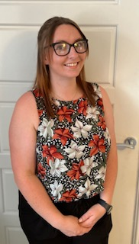

Meet the Staff
Class Teachers
Miss Oxendale
Early Years Foundation Stage Lead
Miss Nasir
We also have Mrs Fielding who will be working with us every morning.

Slide 4

The Foundation Stage
The Foundation Stage is the period of education between the ages of three and five. It starts in Nursery and ends at the end of the Reception year.
Within the Foundation Stage, children work towards achieving the ‘Early Learning Goals’ by the end of the Reception year.

Slide 5
Our School Day
8:30 - Doors open and learning starts!
8:45 - Registration
11:50 - Lunchtime
12:50 – Registration
3:15 - School day ends
Breakfast Club
The school runs an excellent breakfast club from 8am-8.40am for only £1 per day. The children can enjoy a healthy breakfast whilst playing games and talking with their friends.

Slide 6
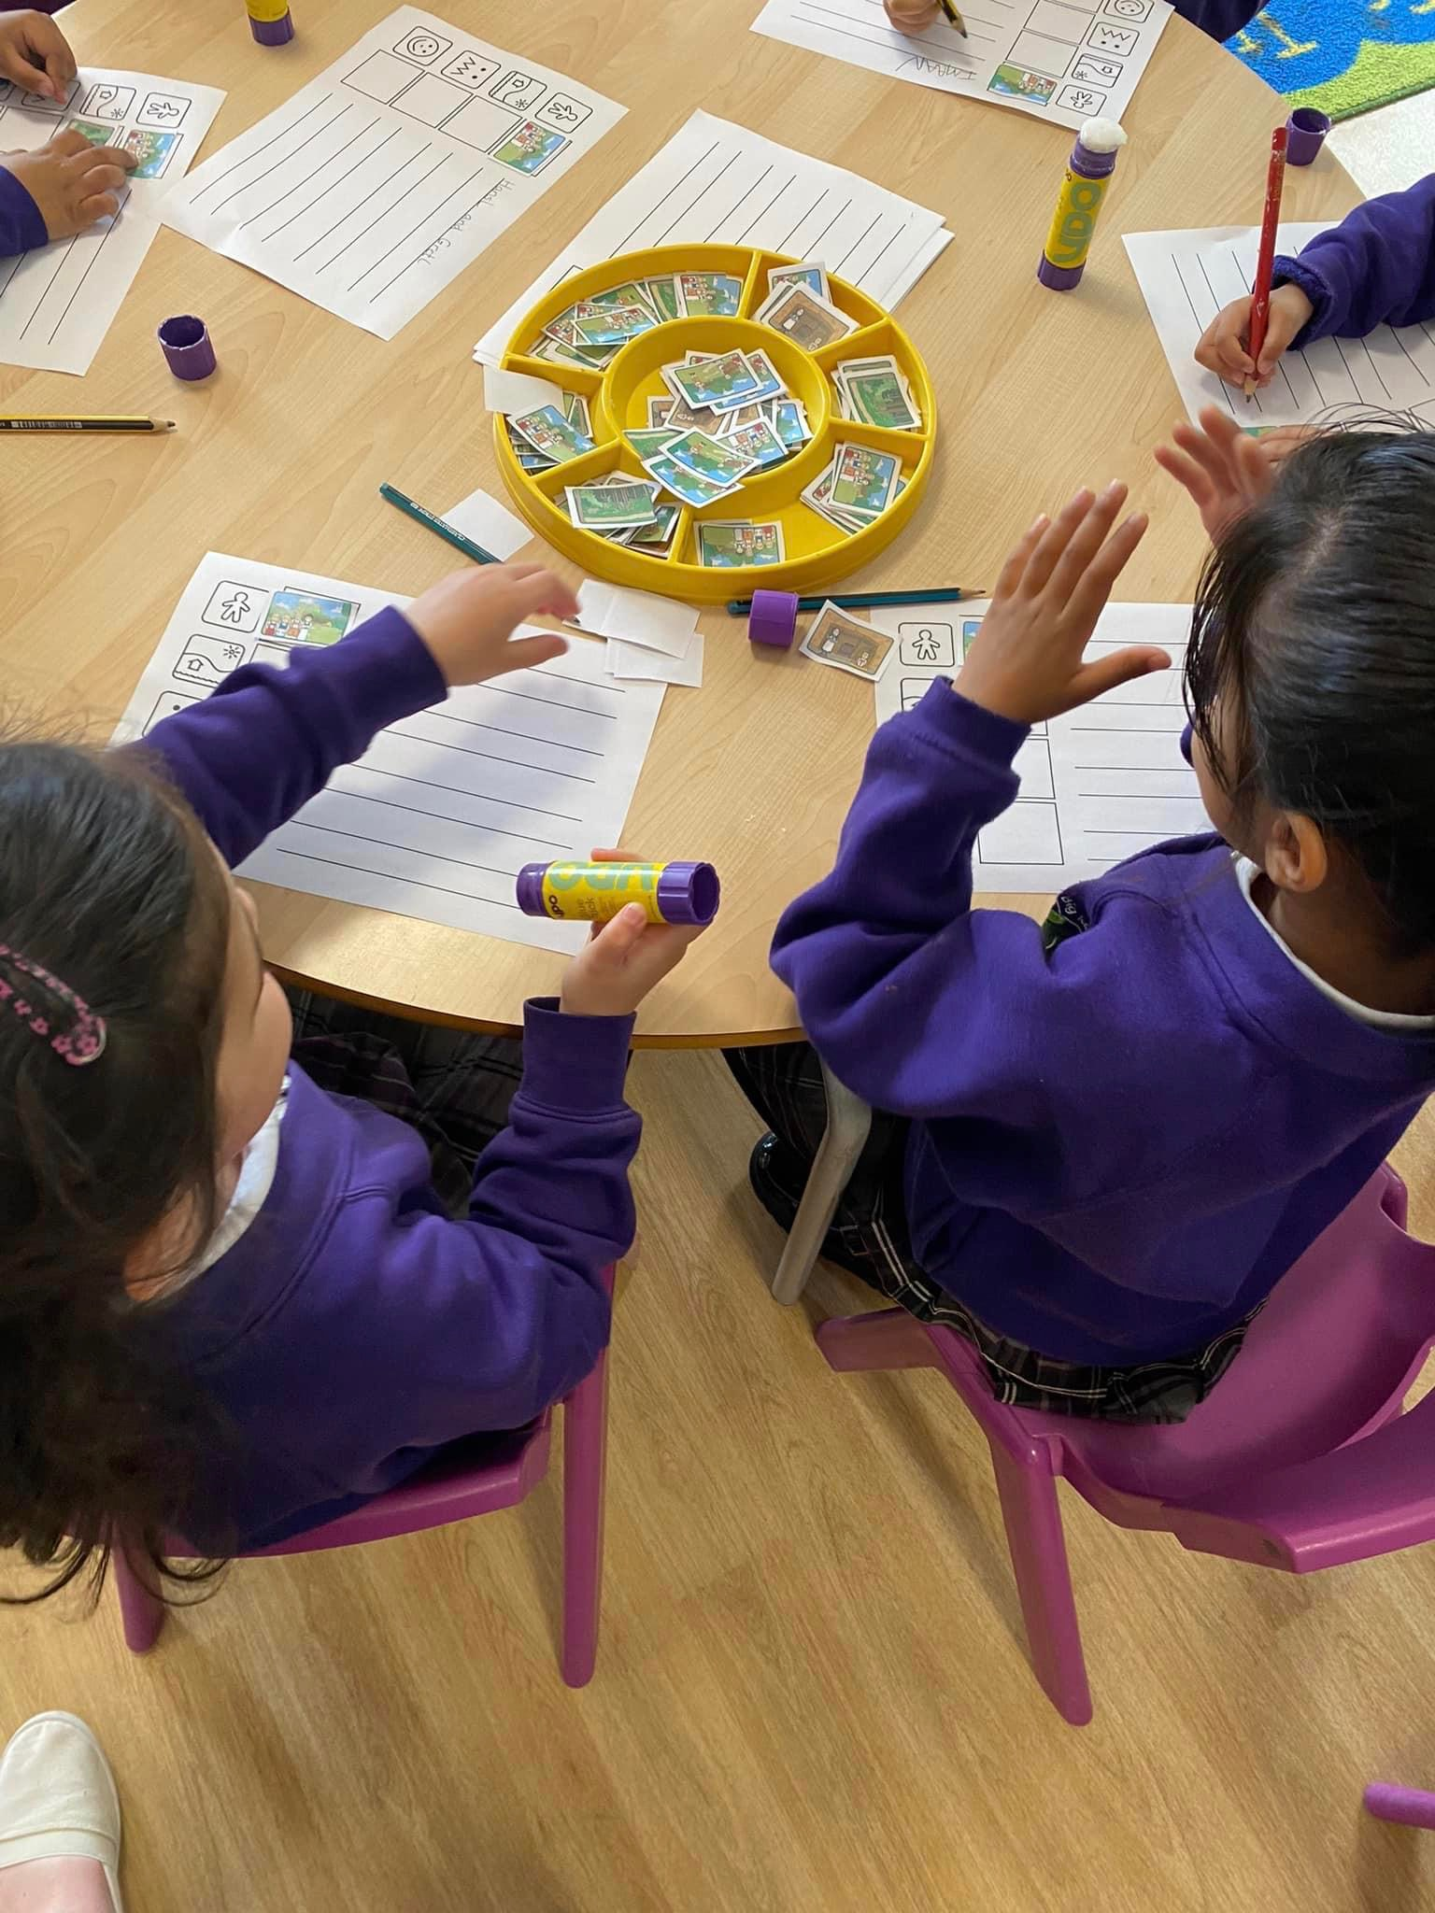
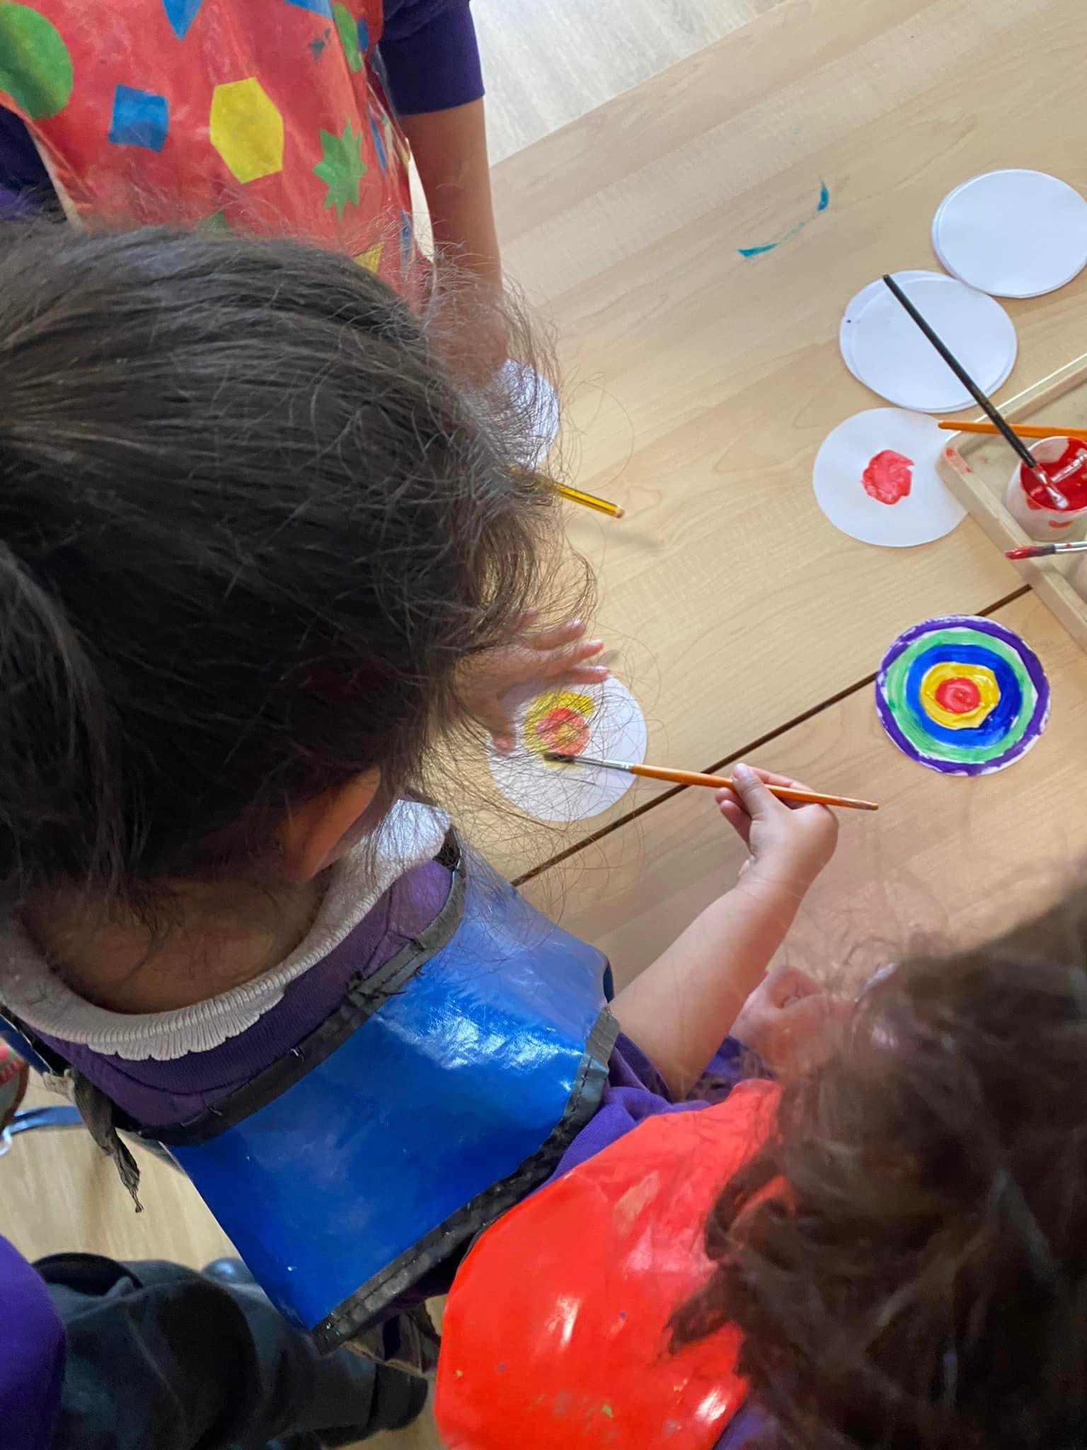
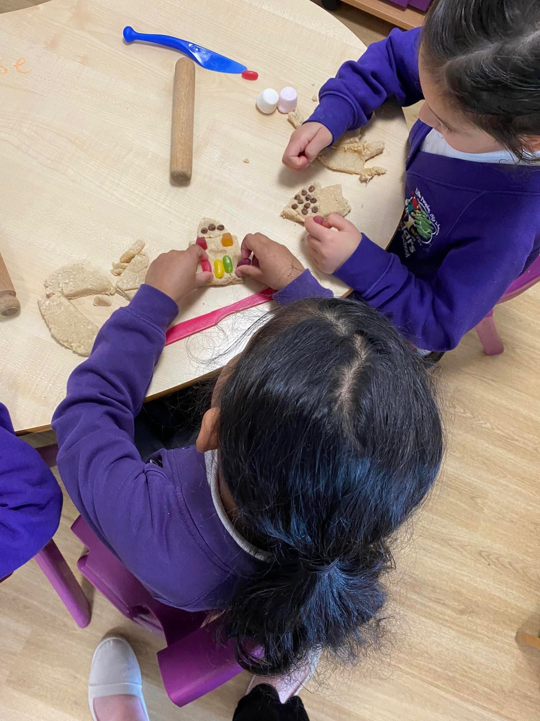
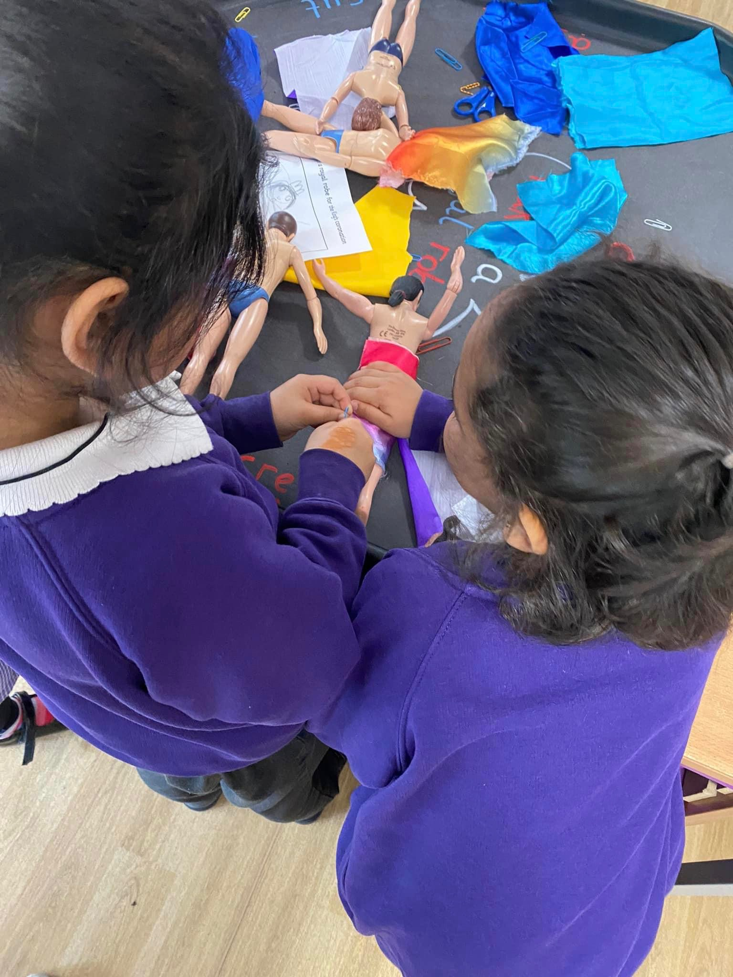
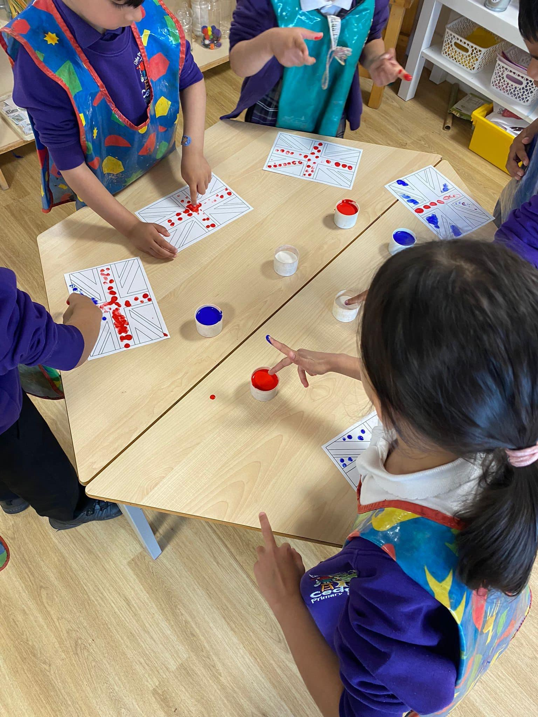
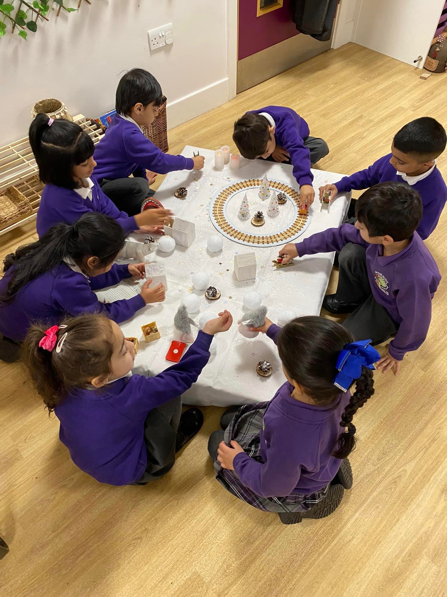
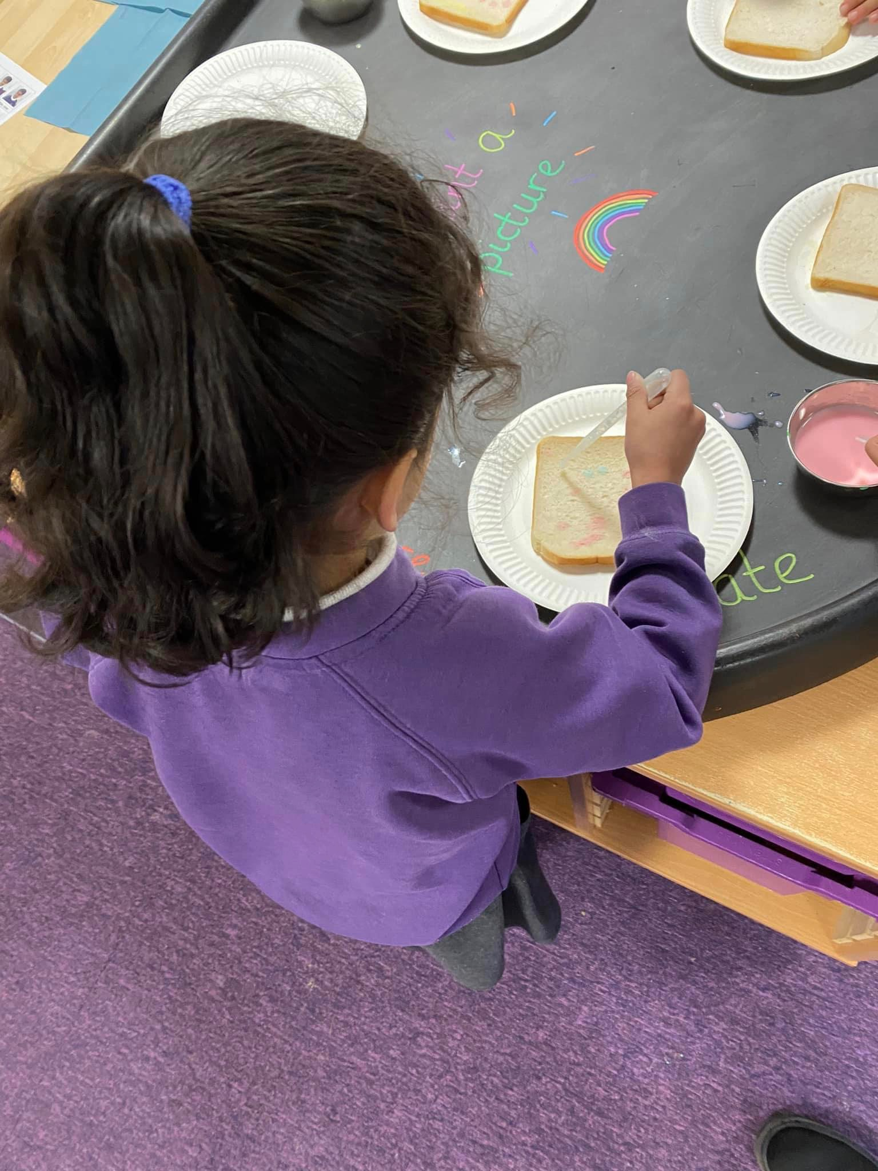
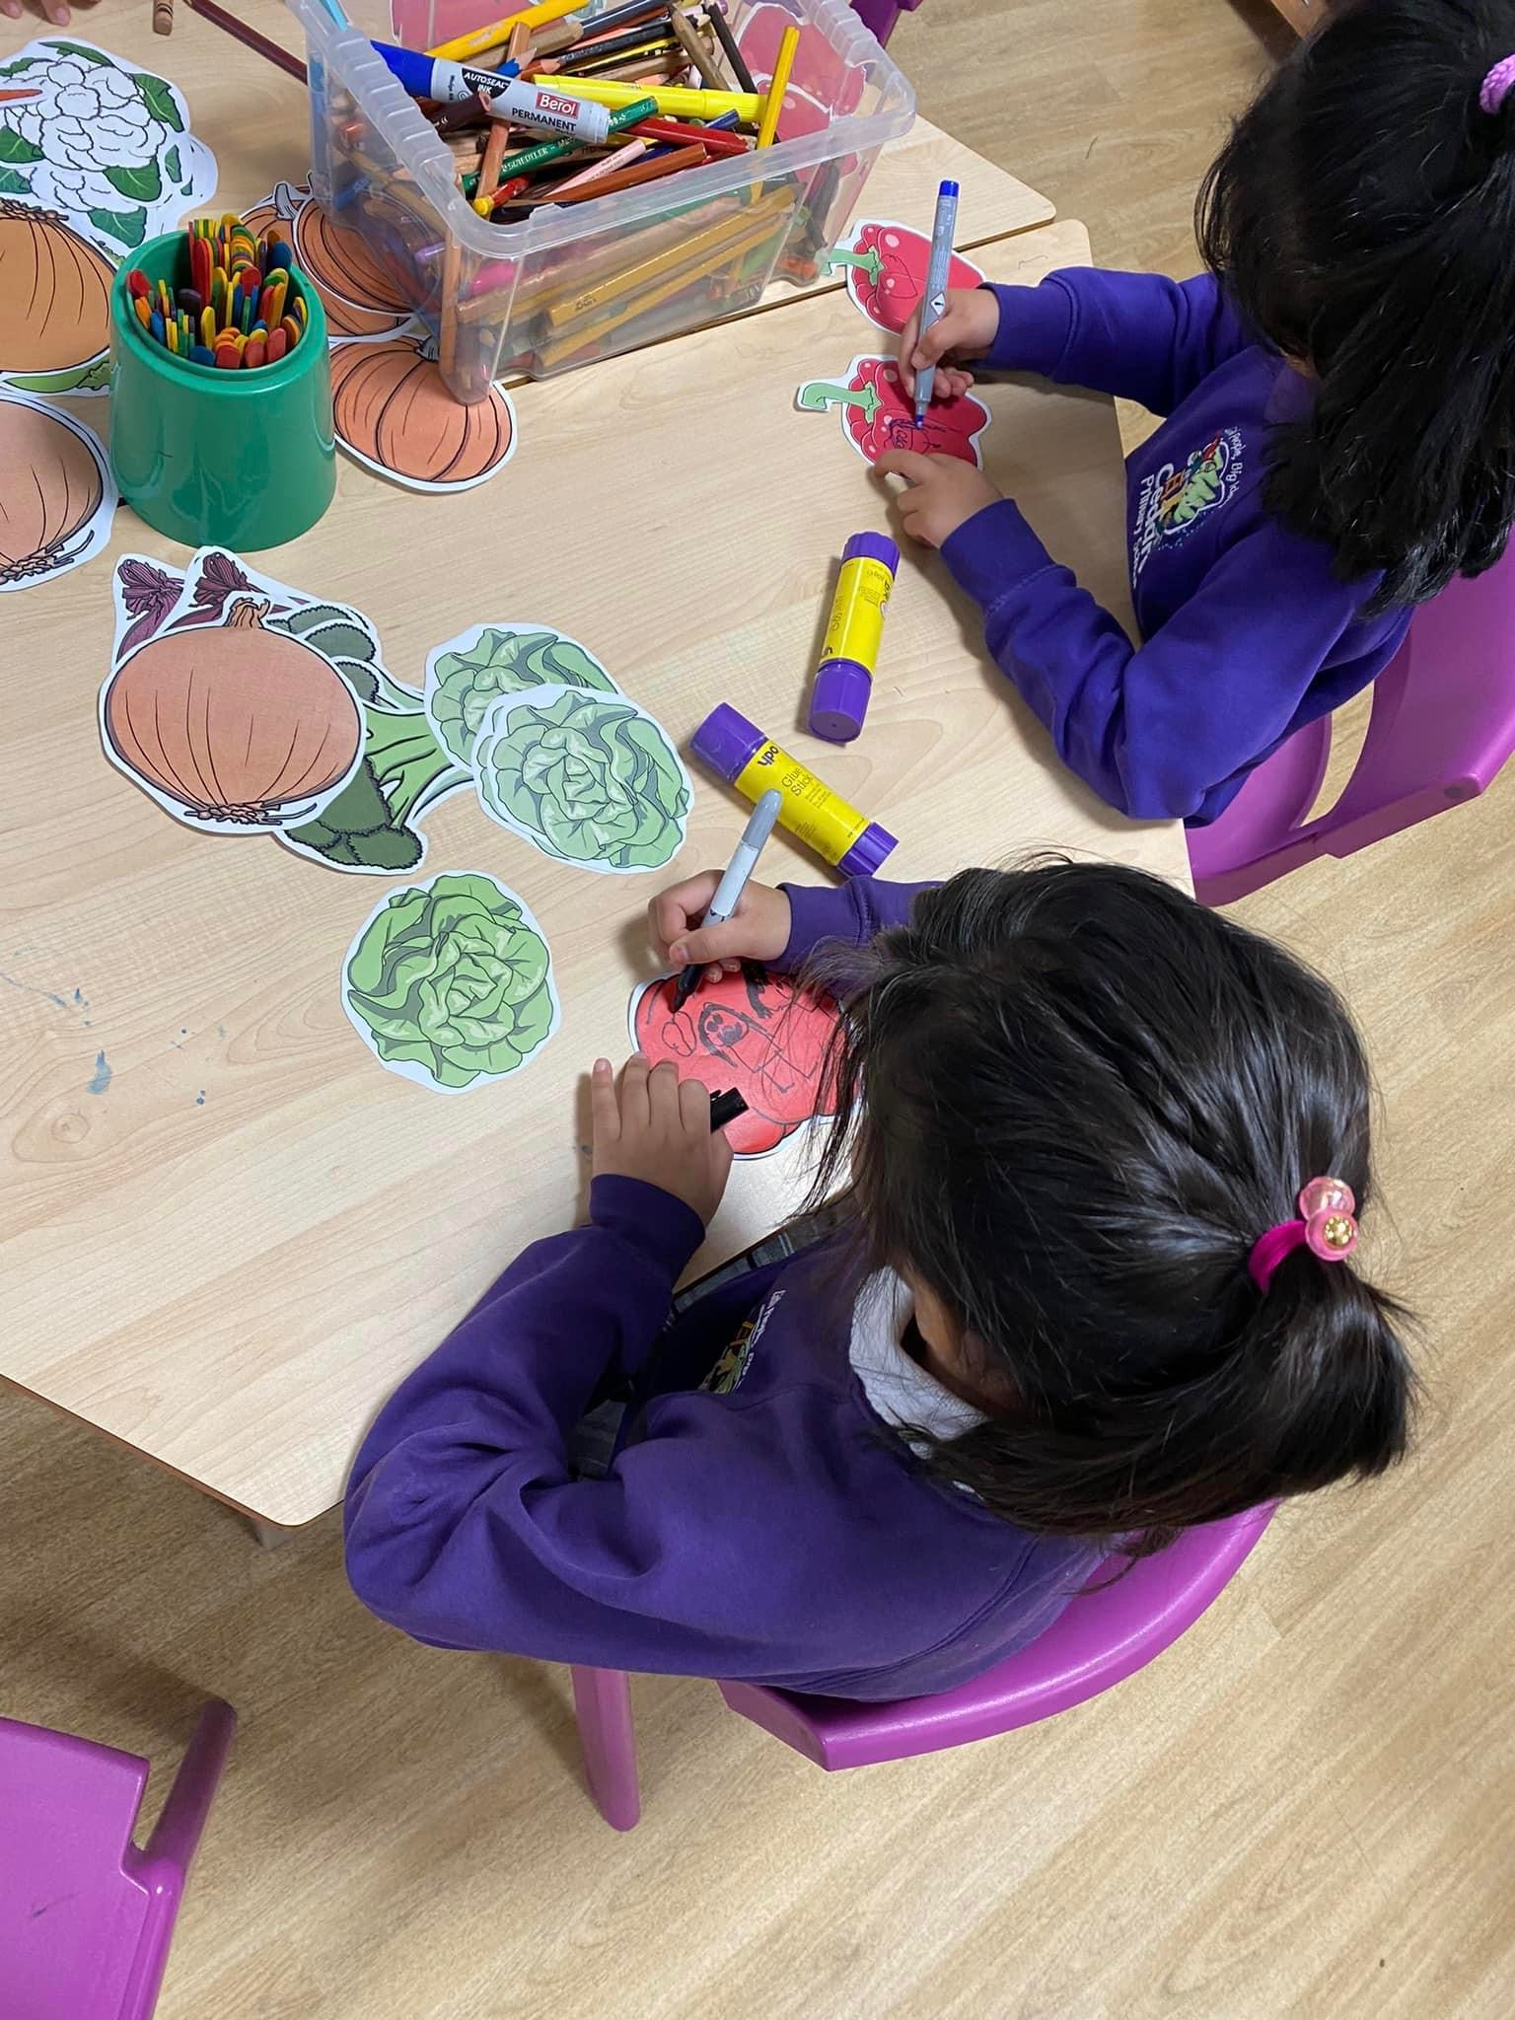
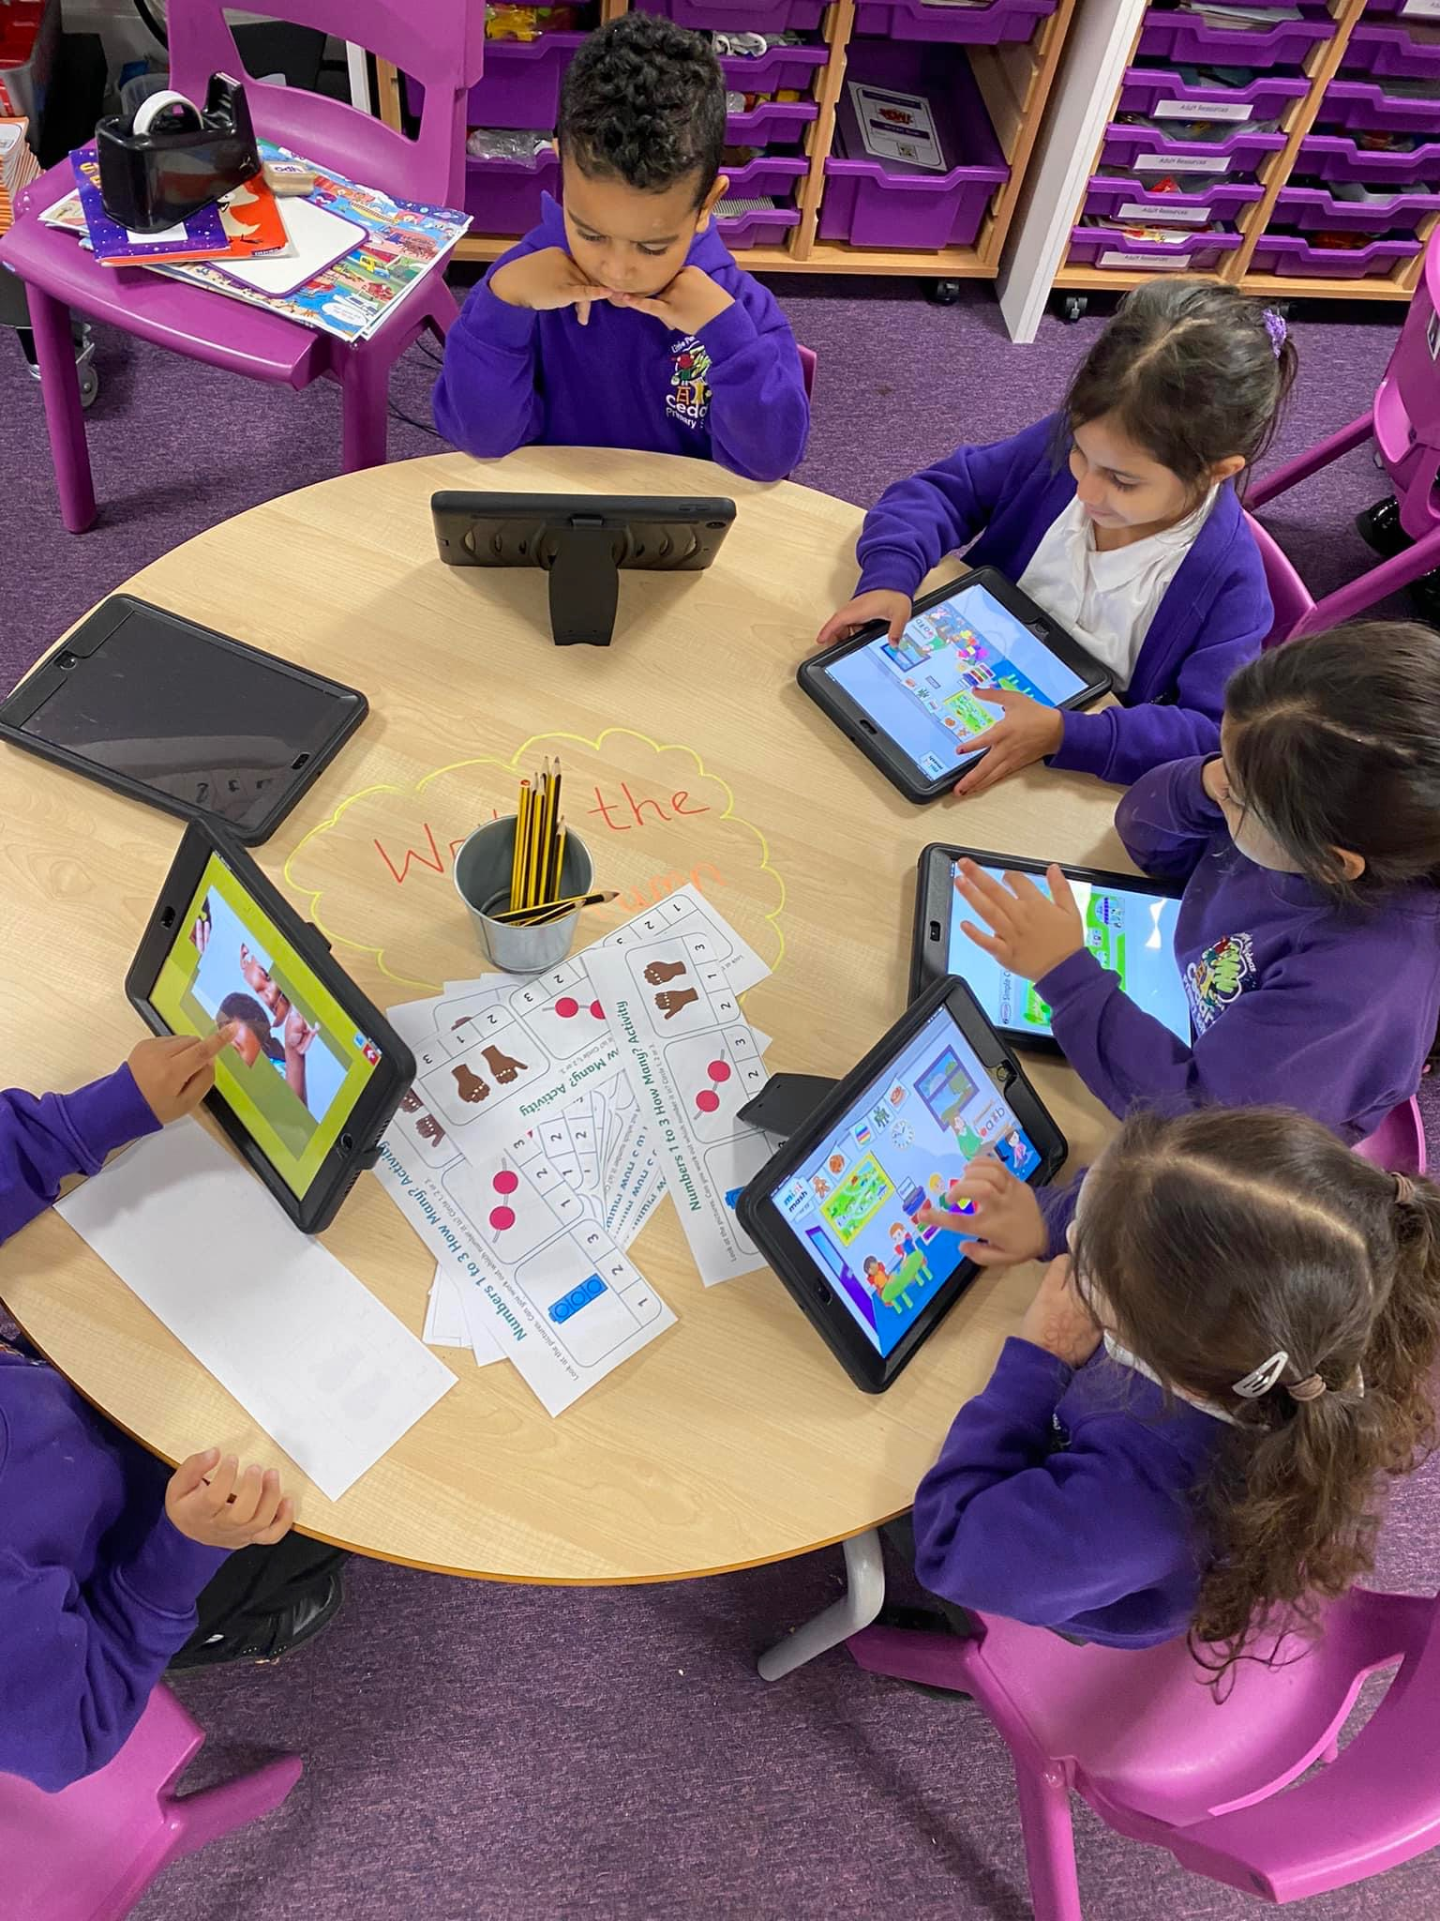
How will my child learn?
Learning in Reception is all about learning through play. The children will be able to choose their own learning and challenge themselves in the provision. As teachers, we will tailor the provision to the children’s interests and needs. We plan for a mixture of child-initiated and adult-led learning opportunities.

Slide 7
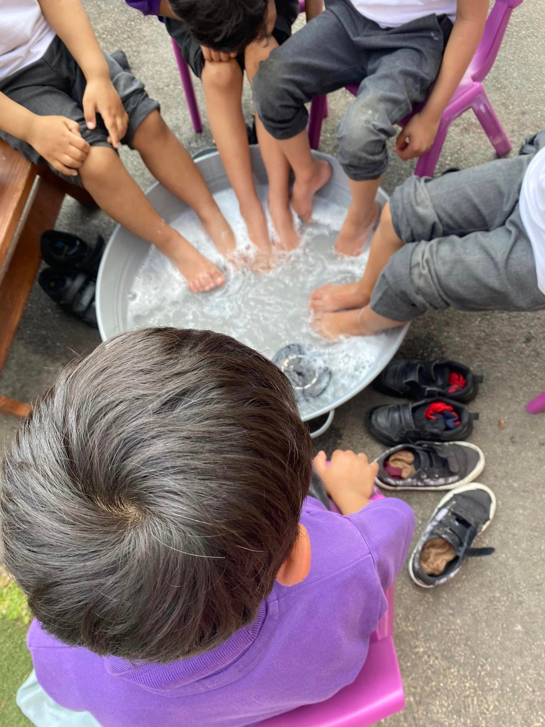
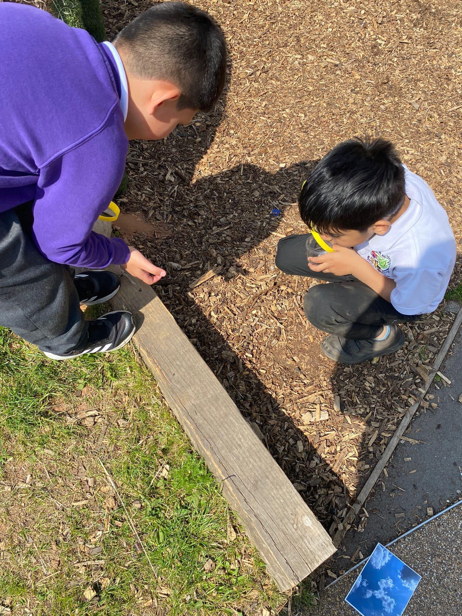
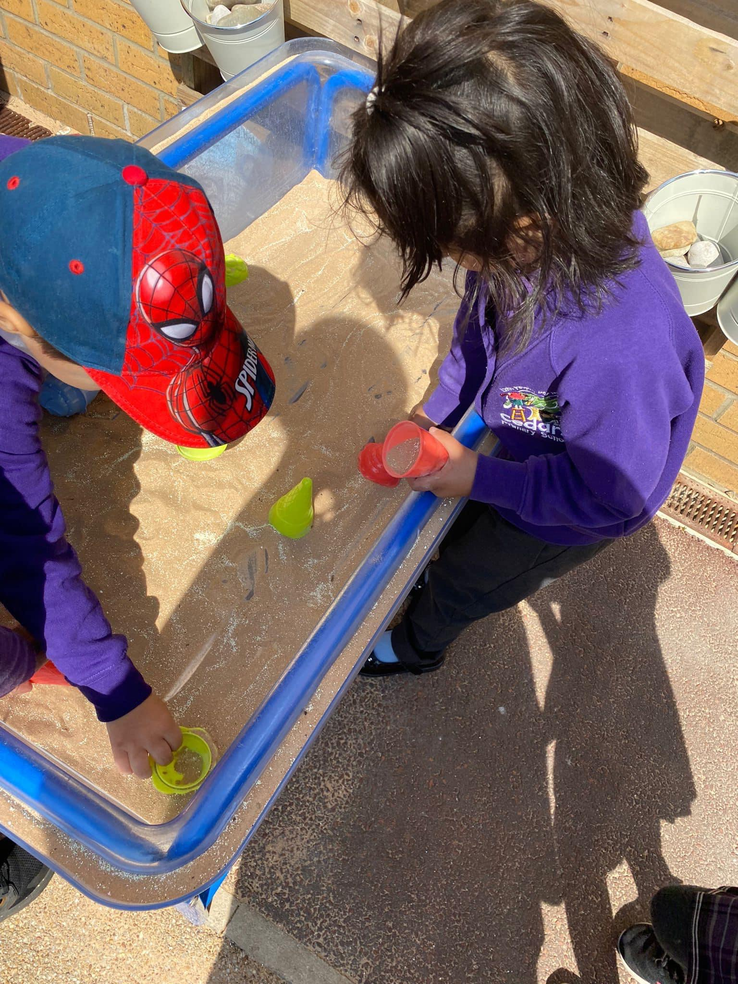
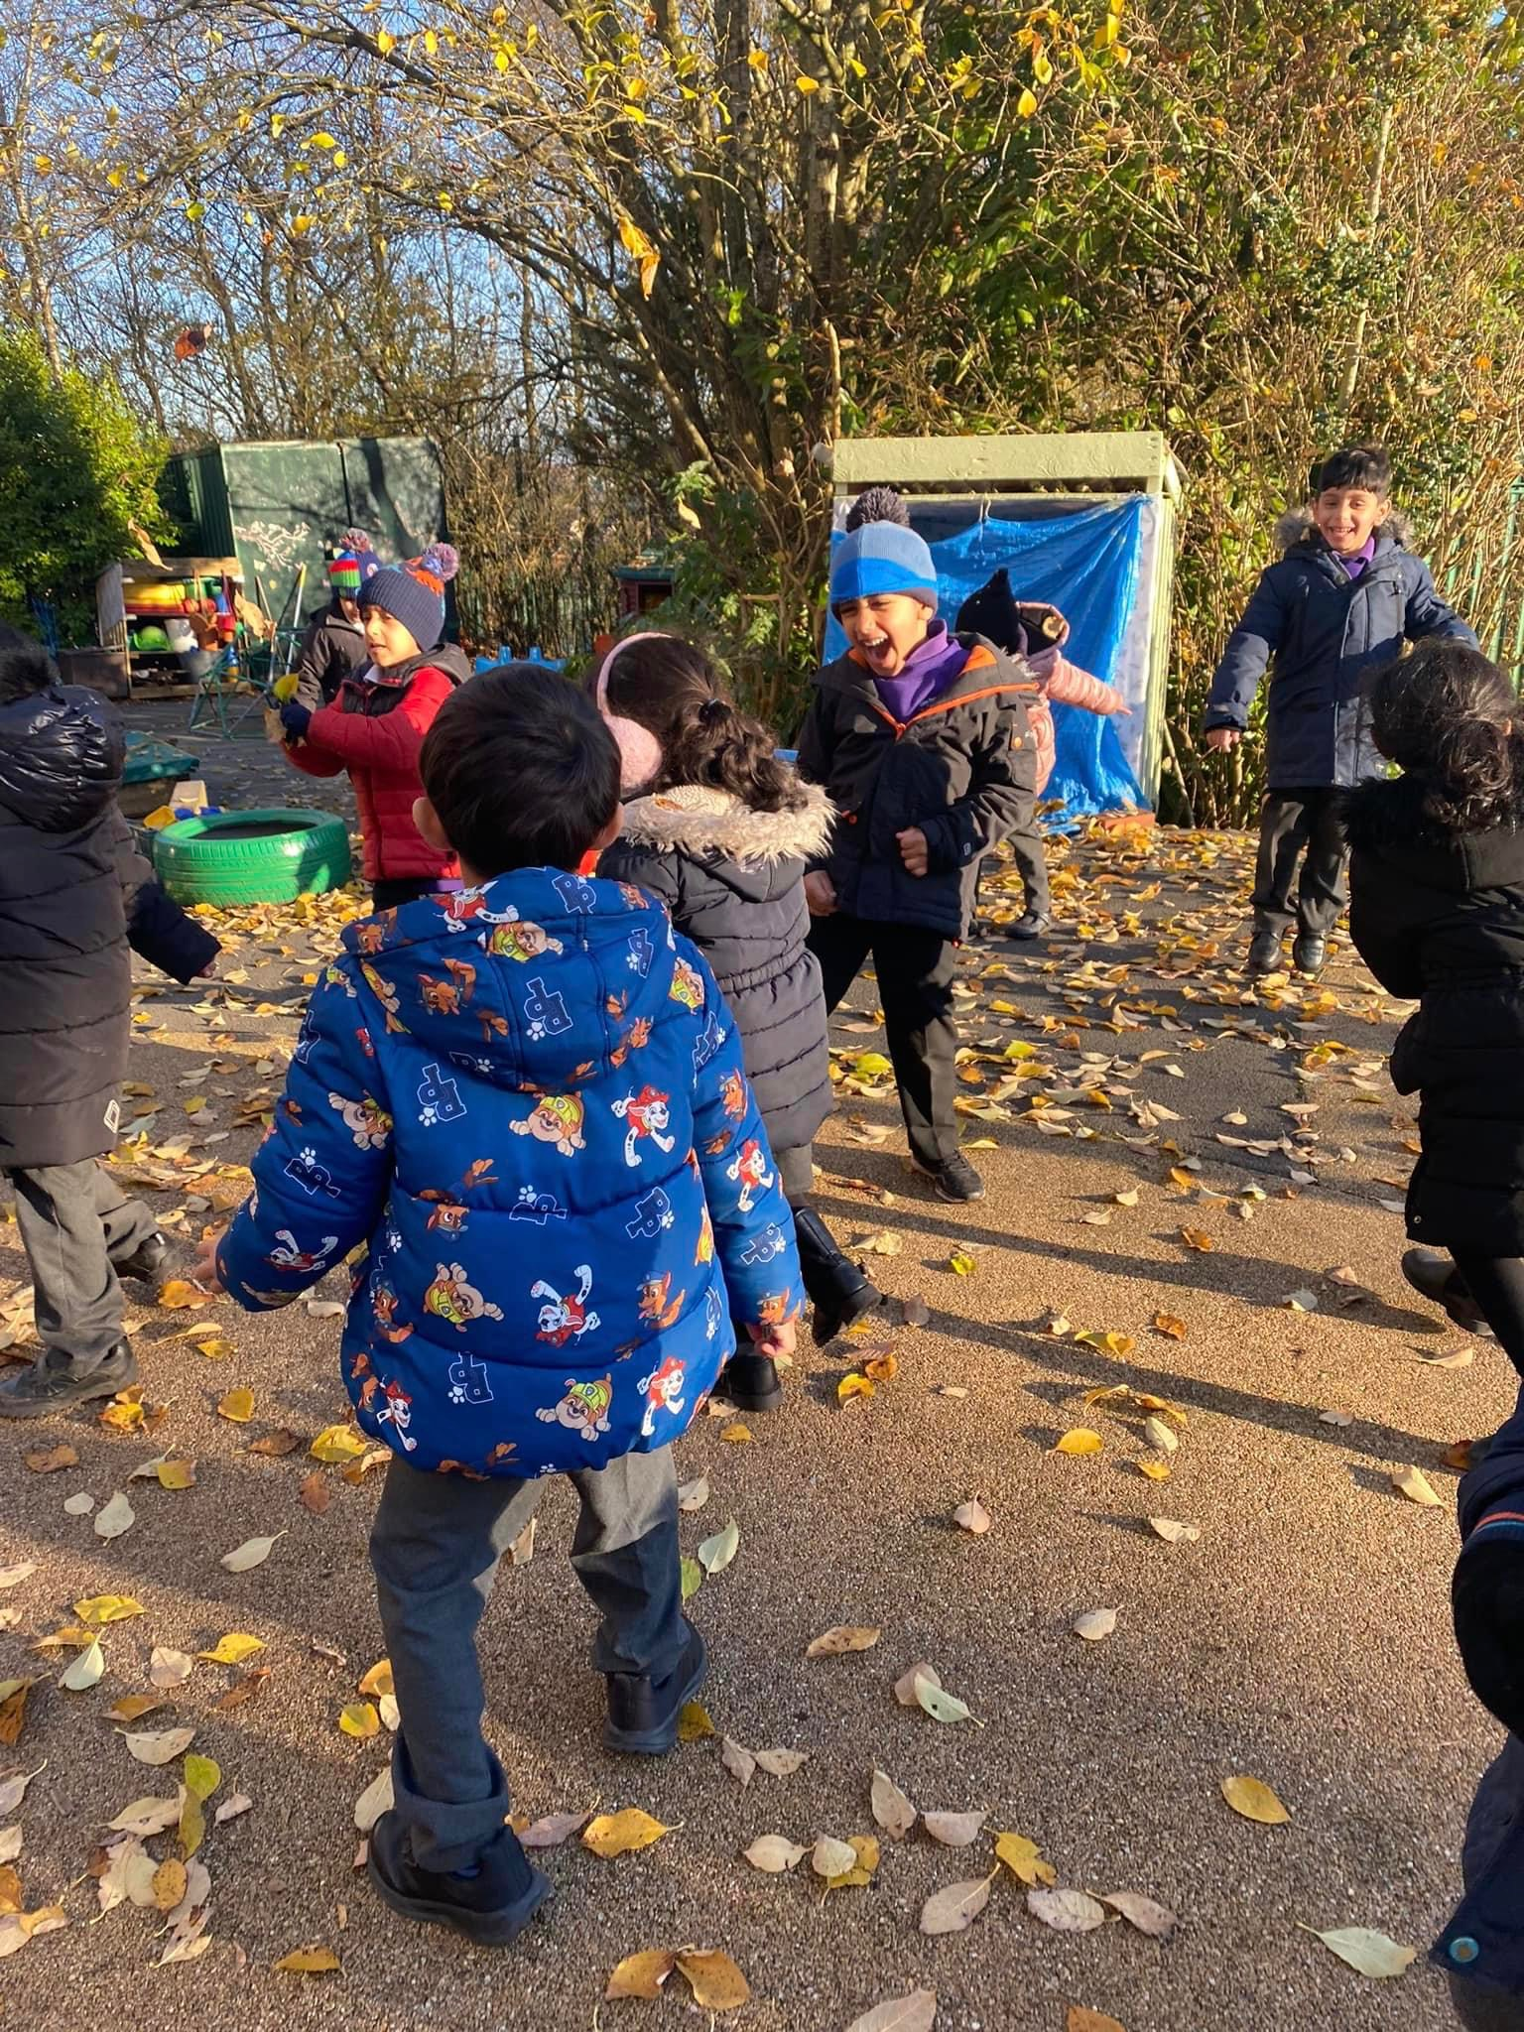
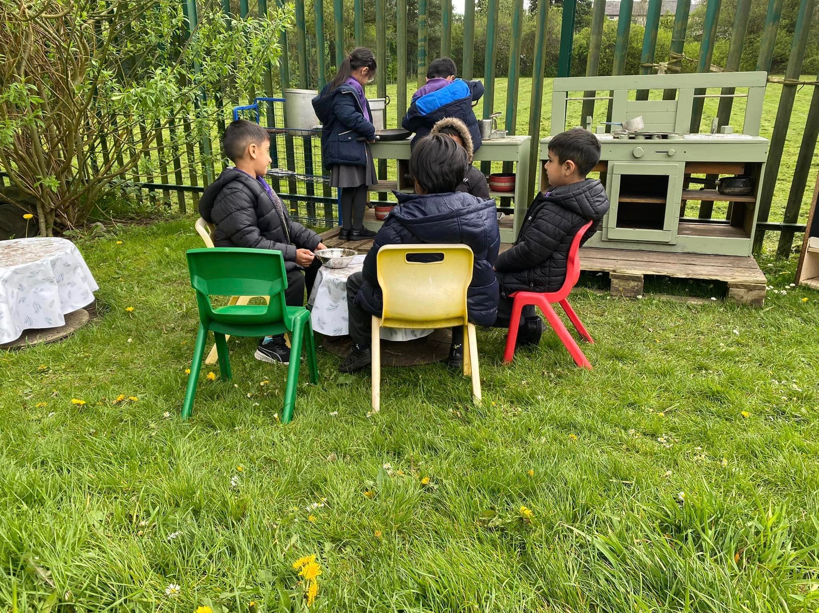
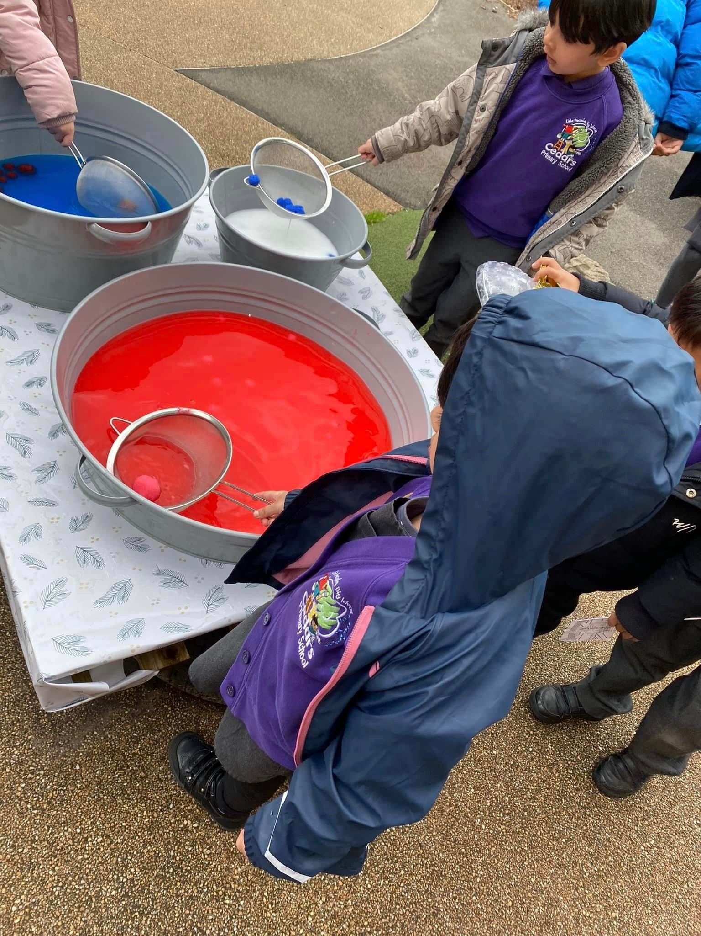
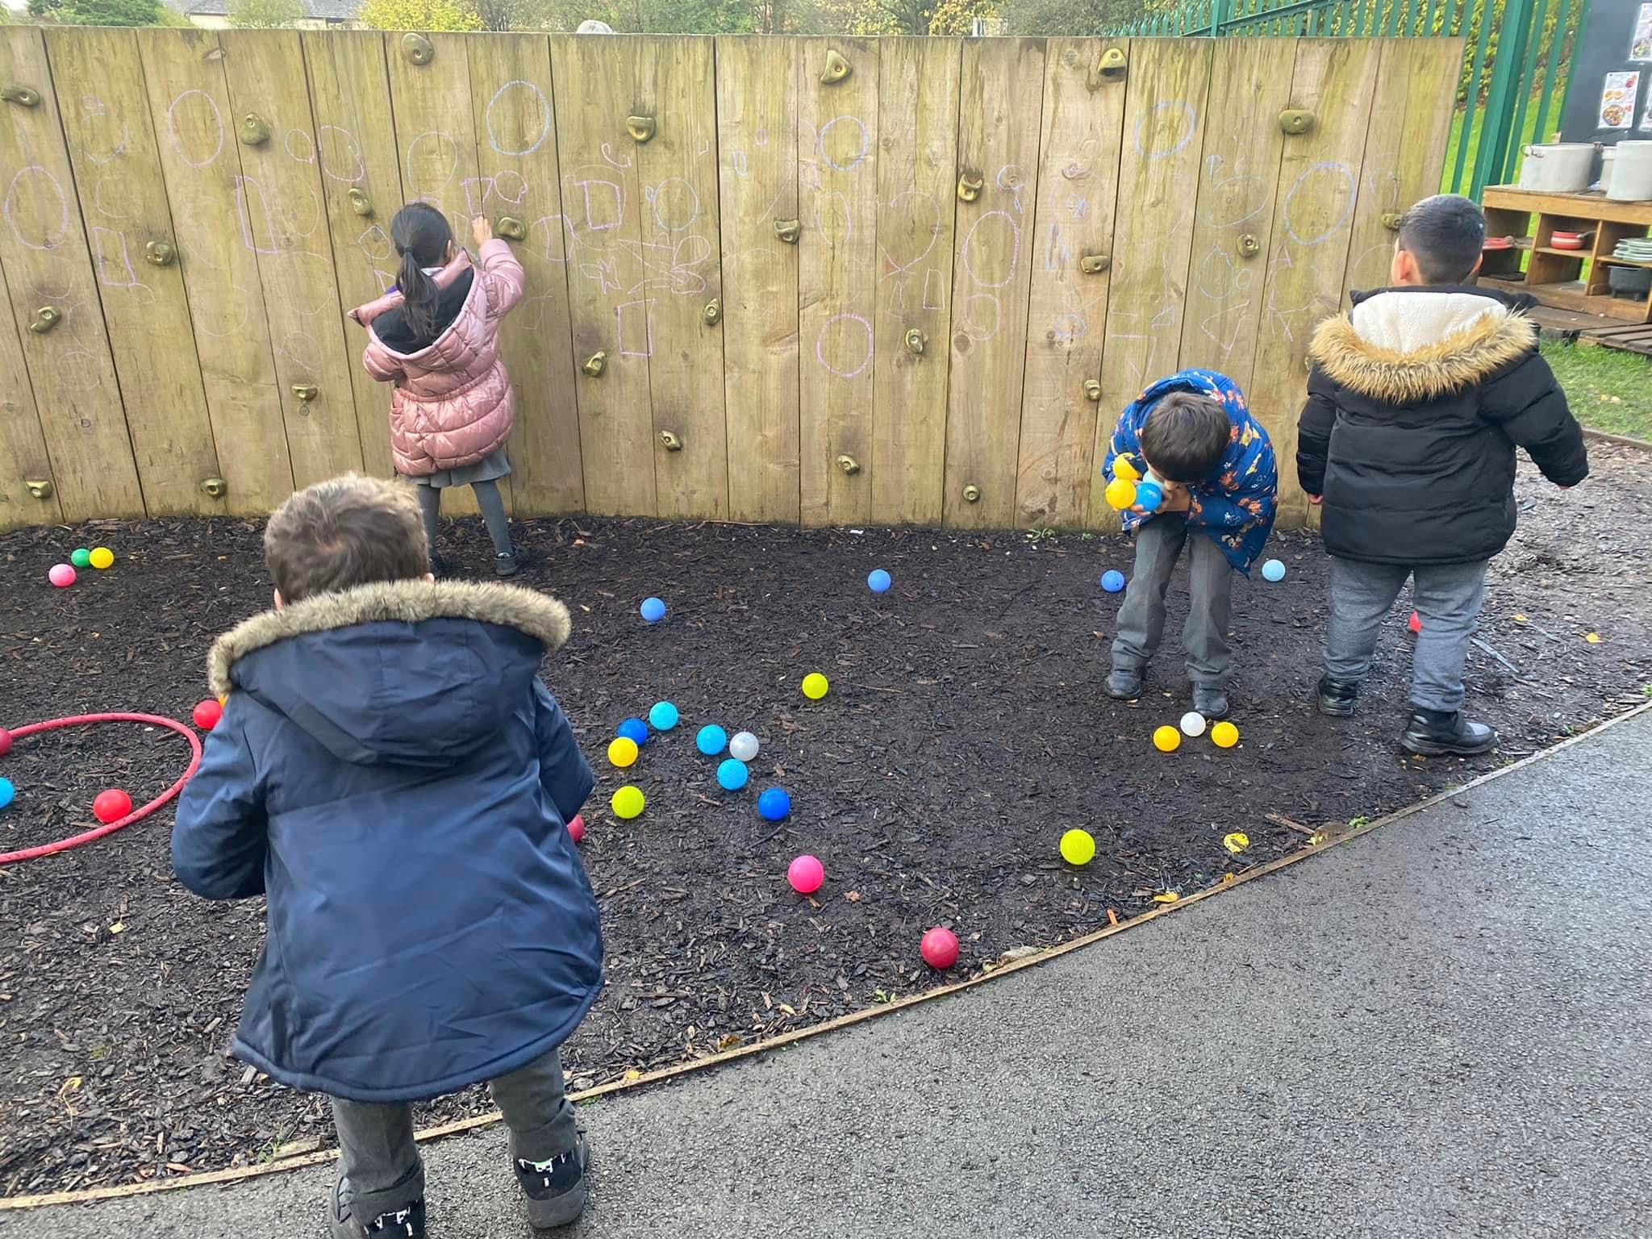
How will my child learn?
Your child will also be able to explore our fantastic outdoor provision.

Slide 8

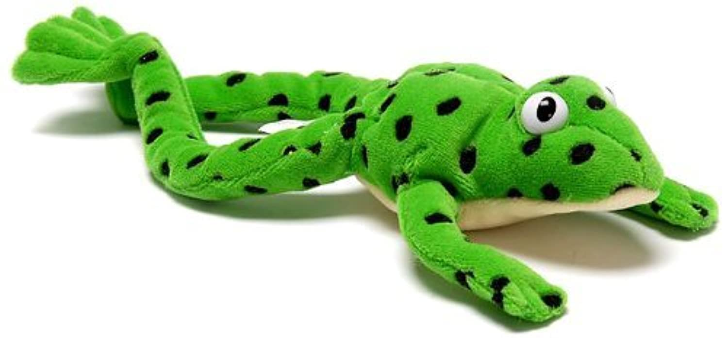

Reading at Cedars
Reading is extremely important to us at Cedars. Reading gives your child the foundation to their learning.
We ask for your support with this, please read your child’s reading book at home with them every day and you sign the reading record.

Slide 9
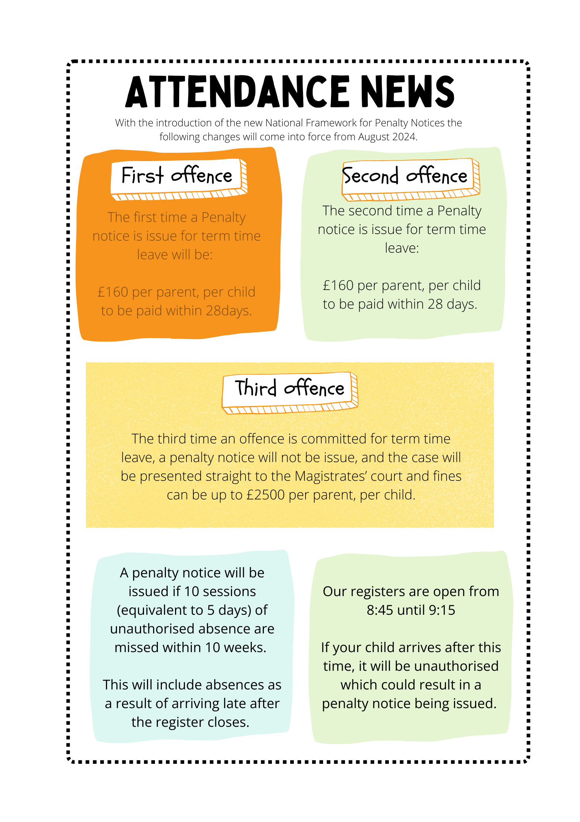

Attendance at Cedars
Attendance at Cedars is extremely important. Each day, children experience amazing learning, and we don’t want them to miss the opportunities.
Please do not take any term time holidays!

Slide 10

What will my child eat and drink?
At Cedars, we always have a wide variety of healthy, balanced meals available at lunchtime. Our menu runs on a 3 week cycle.
Alternatively, your child can bring a healthy packed lunch.
Children attending school are entitled to Free School Meals until Year 2. You can go onto the government website to see if you are entitled to Free School Meals after Year 2 – the link will be emailed out to you all.
Snacks: Children will receive free fresh fruit and milk daily.
Drinks: Water is available throughout the day. Please send children with a water bottle labelled with your child’s name.

Slide 11
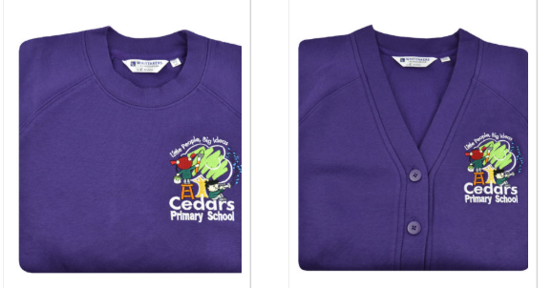

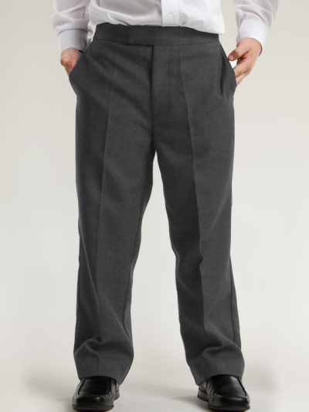
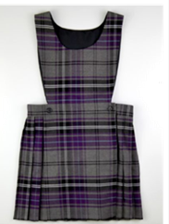
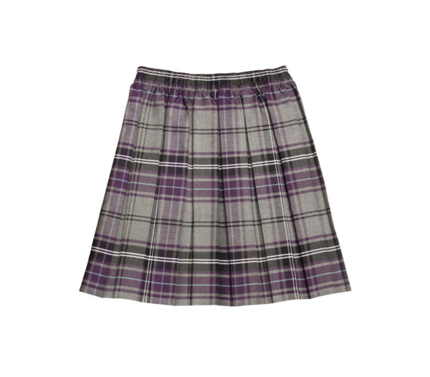
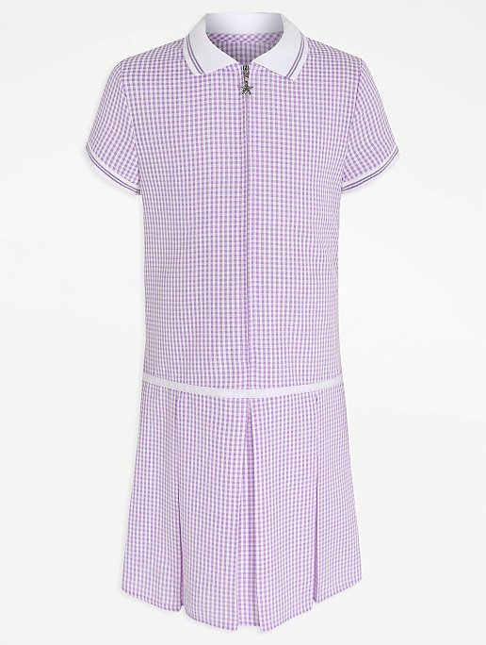
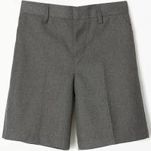
School Uniform
All Children
Purple sweatshirt or cardigan
White polo shirt
Grey trousers, skirt or pinafore
Grey, white or black socks
Sensible black shoes – not trainers
Summertime
Purple gingham or chequered dresses for girls
Grey school shorts for boys
Please write your child’s name in ALL of their clothing.

Slide 12



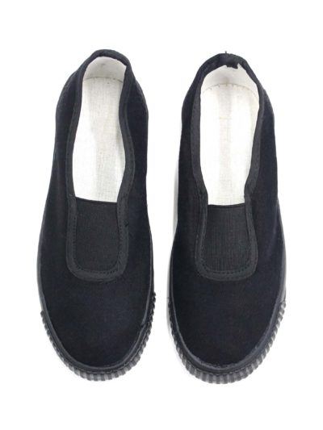
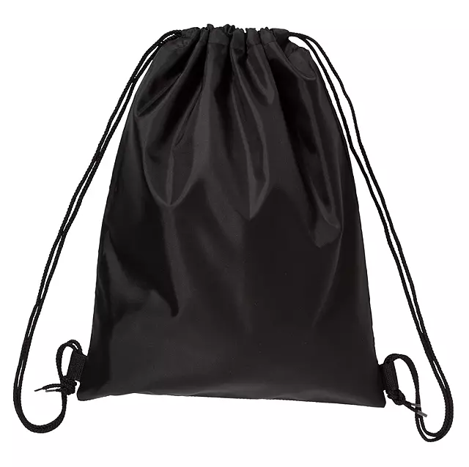
School Uniform
PE Uniform
Black shorts, white t-shirt and black slip-on pumps
Draw-string bag
Hooded purple sweatshirt (Whittakers)
Jewellery
No Jewellery apart from studs – these must be removed on PE days

Slide 13

Purple School Bags
Purple Book Bags:
Purple book bags with the school logo on are also available from Whittakers.
These are to be brought into school every day with your child’s reading book, homework and library book.
Please be sure to check these each evening and empty as needed. Often any correspondence and letter will be in these bags to ensure their safe journey home.

Slide 14

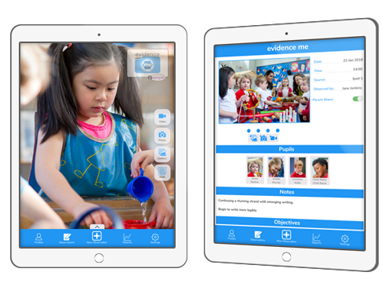

As a school we are going to be using a new system called Evidence Me that will allow us to share what your child is doing in school.
You can download the app onto your smart phone

Slide 15






How can I prepare my child?
Practise these skills with your child:

Slide 16

Website
Our website can we found here:
http://cedarsprimaryschool.co.uk
Here you will find holiday dates, newsletters and updates of what your child has been learning.

