Slide 1
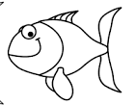

poisson d’avril
oi
on
Practise saying the sounds then say the words.
a
i
r

