Slide 1

Il pleut

Slide 2
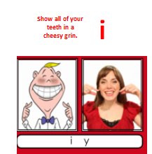
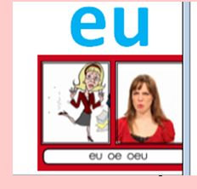
Il pleut
You stand in something horrid and say eu.
Remember, the last consonant in French words is usually silent.

Slide 3
https://www.bbc.co.uk/teach/school-radio/primary-school-songs-apres-la-pluie/zndgvk7
Copy and paste the link to learn a weather song.

