Slide 1
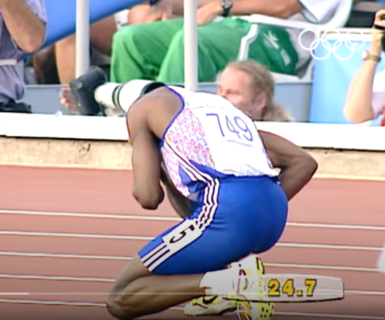
https://www.youtube.com/watch?v=t2G8KVzTwfw

Slide 2


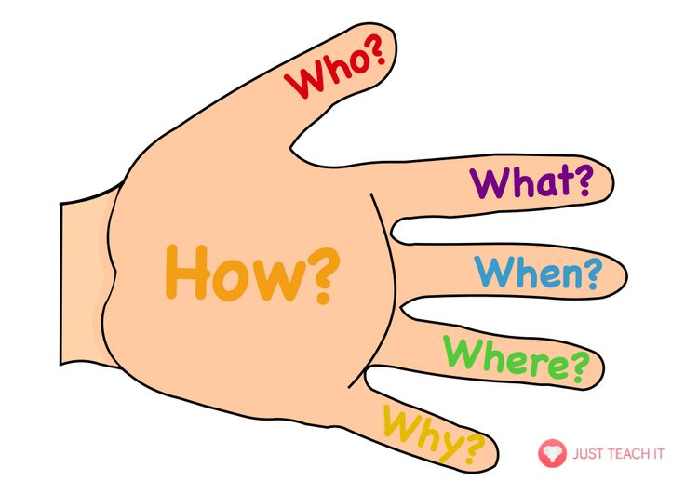
Oracy Rules
Speak confidently and clearly.
Ask someone an appropriate question during discussions.
Always justify your ideas with a reason for your thinking.
I think this because….
I believe this because…

Slide 3


The Signal
What happens when you see a teacher show this signal?

Slide 4

Oracy Detectives
Your teachers will be walking around the room looking at your speaking and listening.
They will be looking for children who make interesting points and who are following the oracy rules.

Slide 5



What is determination?
Sentence Stems:
I would like to start by saying…
I agree/disagree because…
Determination is … because…
An example of determination is…

Slide 6

Why do you think it is important to keep trying even if you fail?
Sentence Stems
I think that it’s important to never give up because…
I agree/disagree because…
When you never give up you…
Great idea! Why do you think that?
Number 2– You are the ‘Silent Summariser’. You must stay silent and listen to the children in your group. You will then feedback the main discussion points in the conversation.

Slide 7
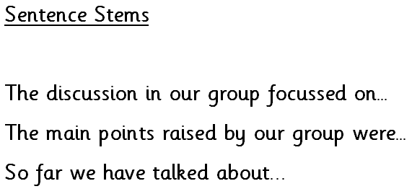
Silent Summariser

Slide 8
Oracy Detective Feedback
Your teachers will be walking around the room looking at your speaking and listening.
They will be looking for children who make interesting points and who are following the oracy rules.

Slide 9
Prayer
Dear God,
Please help us to have the strength to challenge and push ourselves to do our best and let us remember that if we fail, we can try again until we become better.
Amen

Slide 10
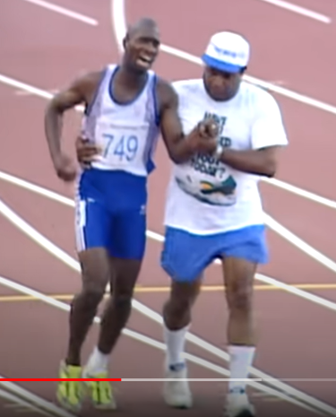

Reflection
How can you show determination at school today?

