Slide 1
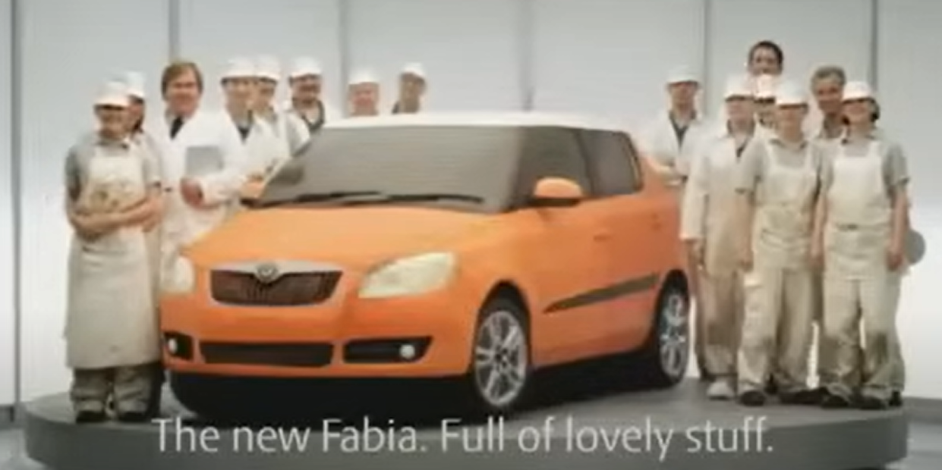
Intro

Slide 2

Oracy Assembly
Wednesday 10th September 2025

Slide 3


Oracy Assembly Rules
Speak confidently with a loud voice.
Listen to others carefully.
Ask someone a question.

Slide 4

The Signal
What happens when you see a teacher show this signal?

Slide 5

Oracy Detectives
Your teachers will be walking around the room looking at your speaking and listening.
They will be looking for children who make interesting points and who are following the oracy rules.

Slide 6


Today we are going to be talking about teamwork!
What is a team?
15 seconds

Slide 7
What is a team?
A team is a group of people who work together to do something. Just like how you play games with your friends or help each other in class, being in a team means everyone helps and works together to reach a goal.
For example:
A football team works together to score goals and win the game.
In class, your table group might work as a team to solve a puzzle.

Slide 8
What Makes a Good Team?
Helping Each Other: Everyone in the team helps and cares for each other.
Listening: A good team listens to everyone's ideas, so everyone feels included.
Sharing: A team shares jobs so that everyone can take part.
Being Kind: Saying kind words and encouraging each other makes the team happy.
Working Together: Everyone tries their best and works towards the same goal.

Slide 9
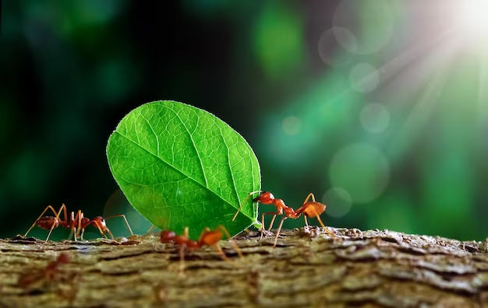
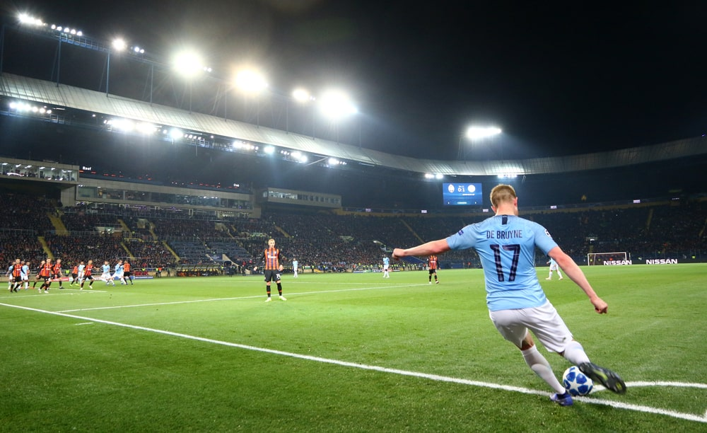
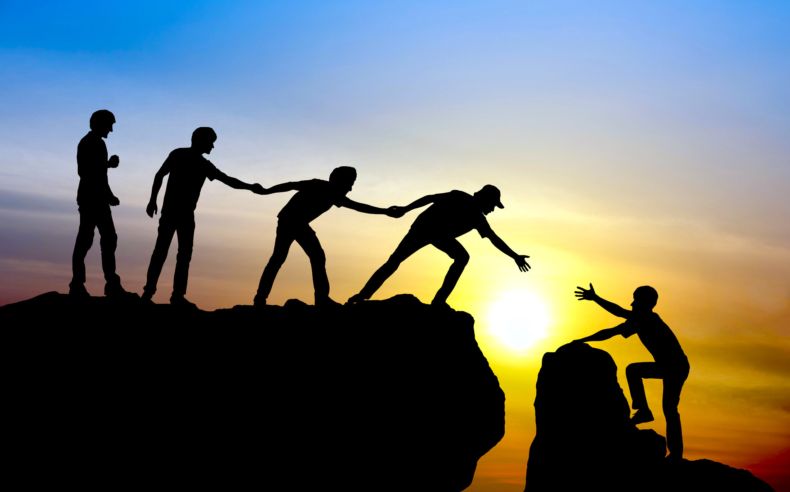
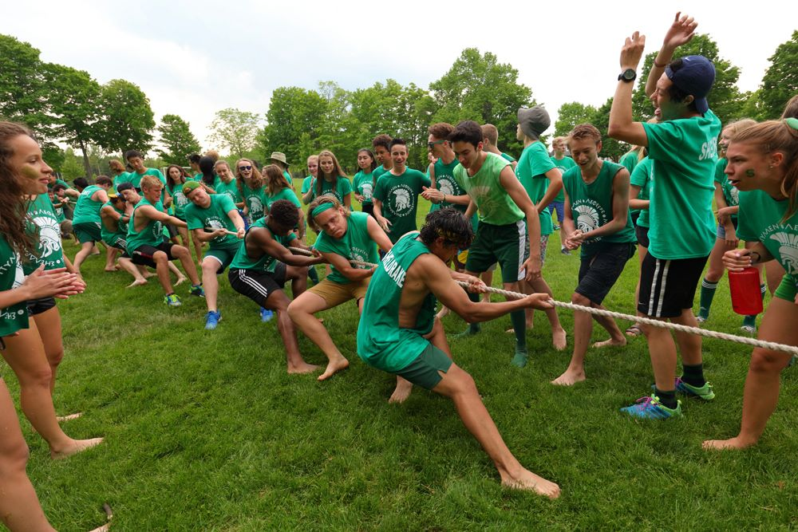

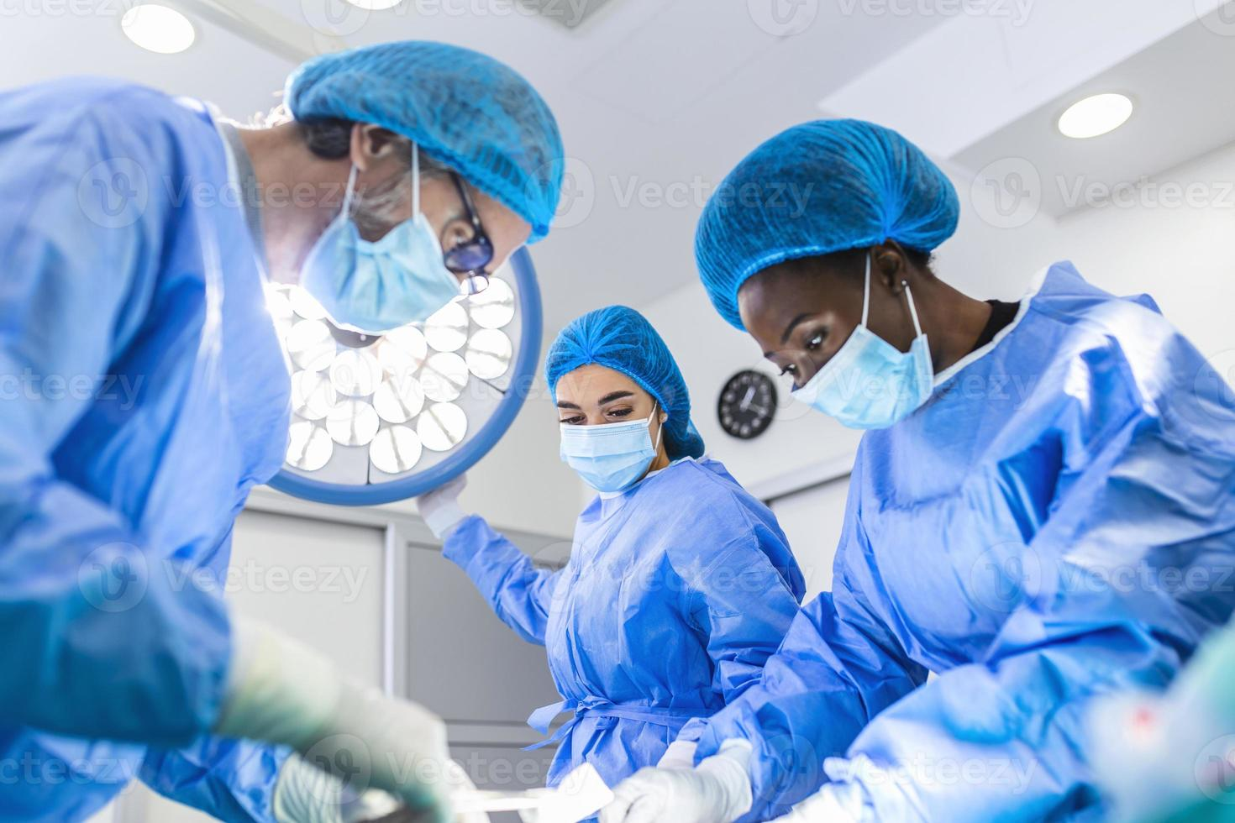
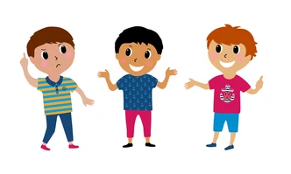
How does each picture show teamwork?
Who would like to start?
I think ___ because ___
I agree/disagree with ____ because ______

Slide 10
Think about the TV advert that you watched whilst you were walking into assembly.
What different jobs will have been needed to make this advert? Think about what you can see and what you can’t see (behind the scenes)!
‘I believe that the advert needed someone to ____________ because ________’
Year 2/4 – You are the ‘Silent Summariser’. You must stay silent and listen to the children in your group. You will then feedback the main discussion points in the conversation.

Slide 11
Silent Summariser
Can you name the different roles that may have been needed to produce this advert?
“In our group, we talked about ___________.”
Can you use the sentence stem?

Slide 12

When I work in a team, I end up doing a lot of the work myself as nobody else can do it as well as I can.
I love working in a team. We share all of the jobs and end up completing our tasks quickly.
I enjoy working as a team when completing some tasks. I also like working by myself sometimes!
Thumb in if you agree

Slide 13
This half-term, look for any examples of amazing teamwork around school.

Slide 14
Oracy Detective Feedback
Your teachers will be walking around the room looking at your speaking and listening.
They will be looking for children who make interesting points and who are following the oracy rules.

Slide 15

Belly Breathing
https://www.youtube.com/watch?v=RiMb2Bw4Ae8&list=PLNw7FtQouczClTo_QfAg9I3vMaJzoPduq&index=4

