Slide 1



Guess the Authors
https://www.youtube.com/watch?v=dx06uDuQlZE
Monday 8th September 2024
https://clubs-kids.scholastic.co.uk/authors/6817
https://www.youtube.com/watch?v=-EM8K6MEA-8

Slide 2
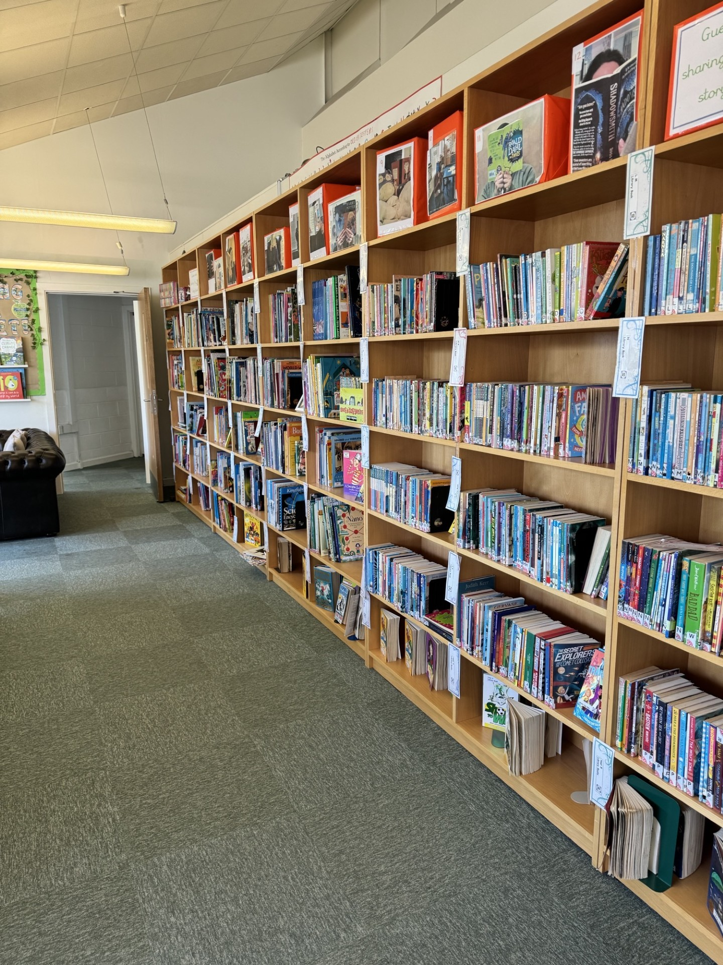
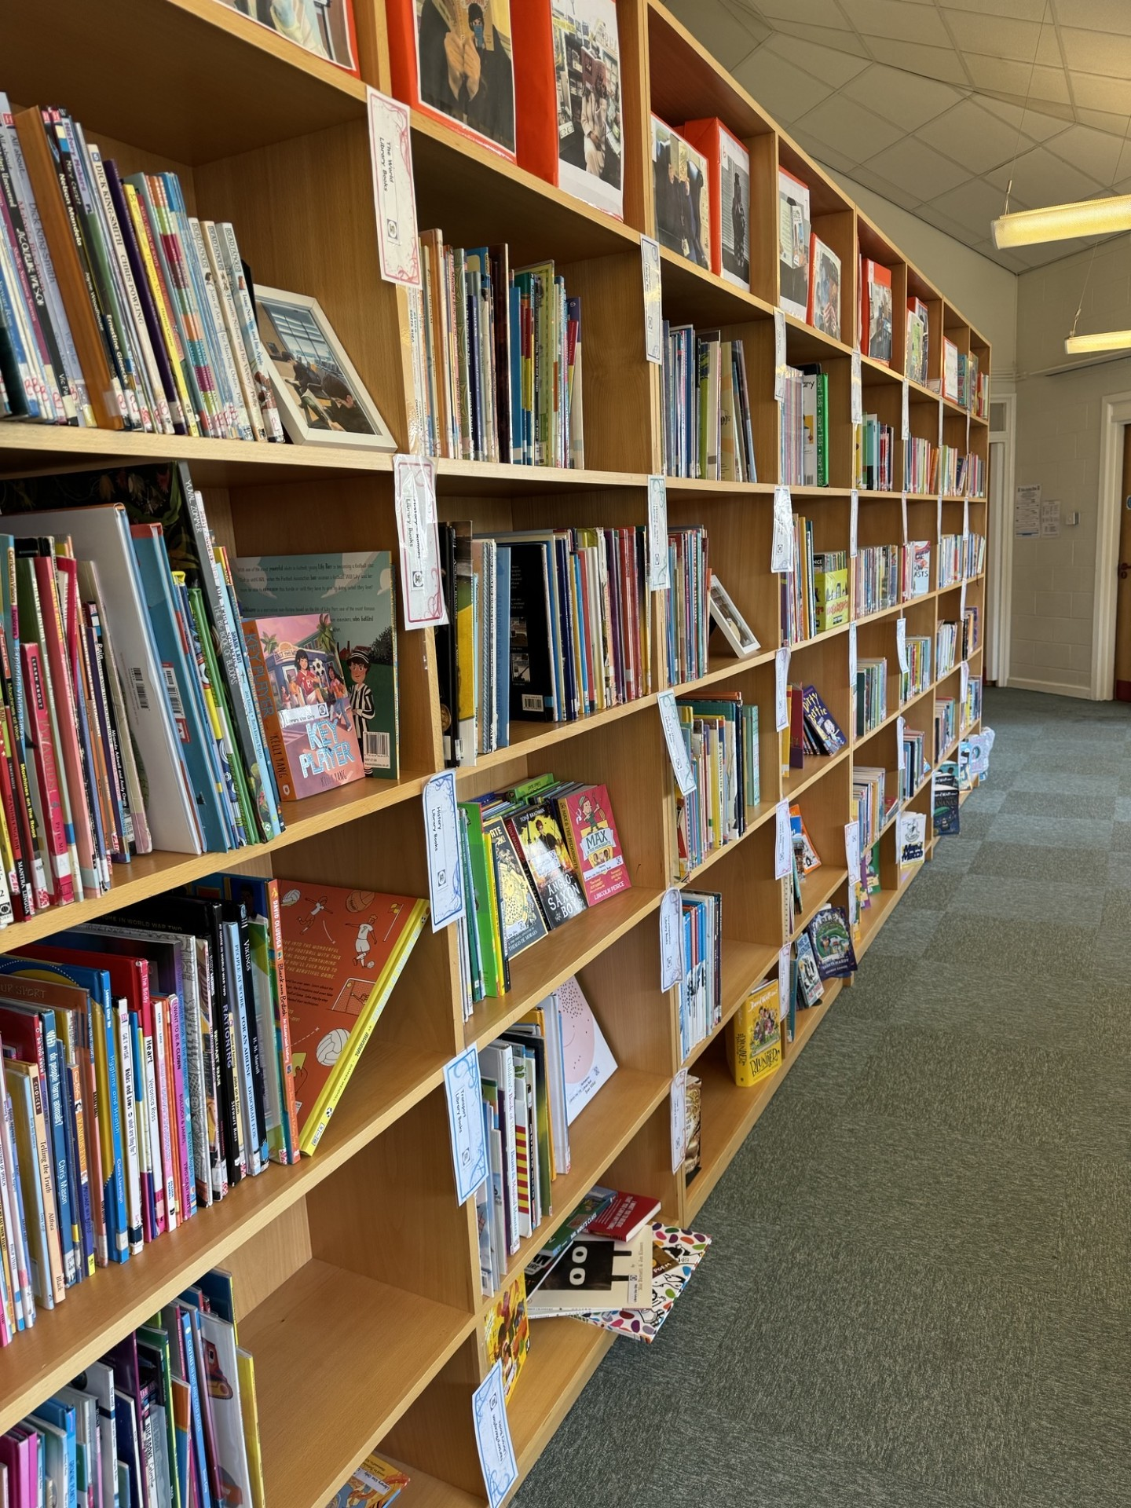
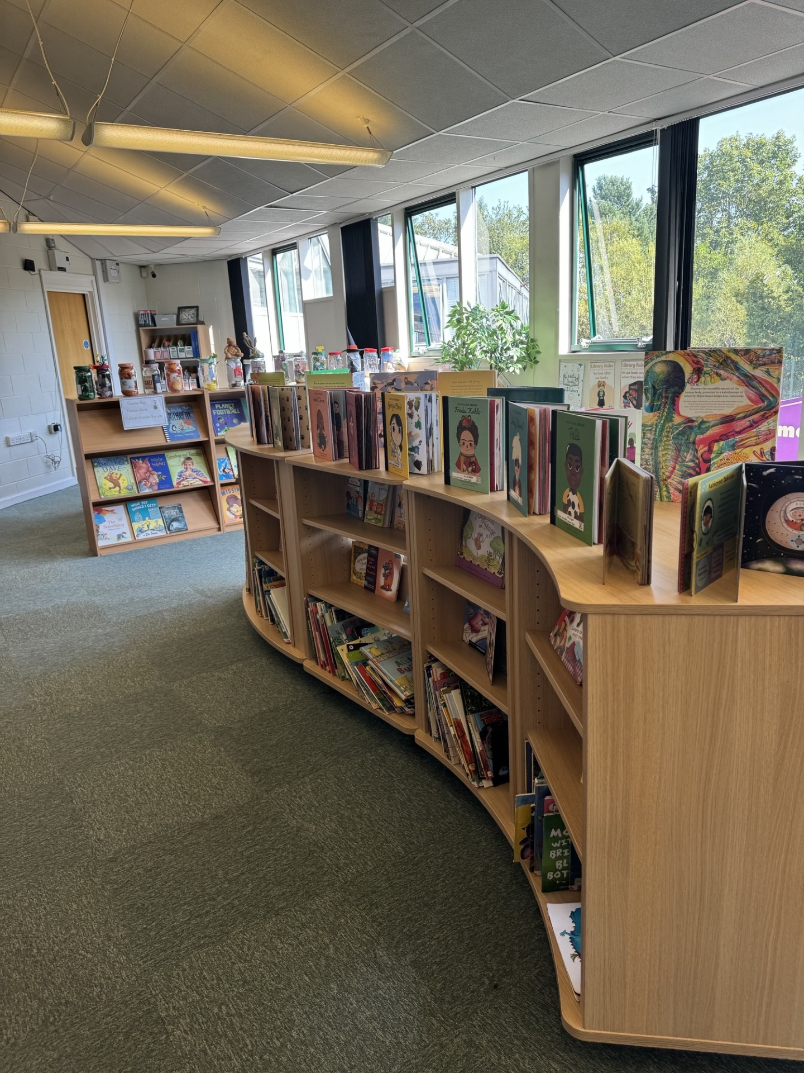
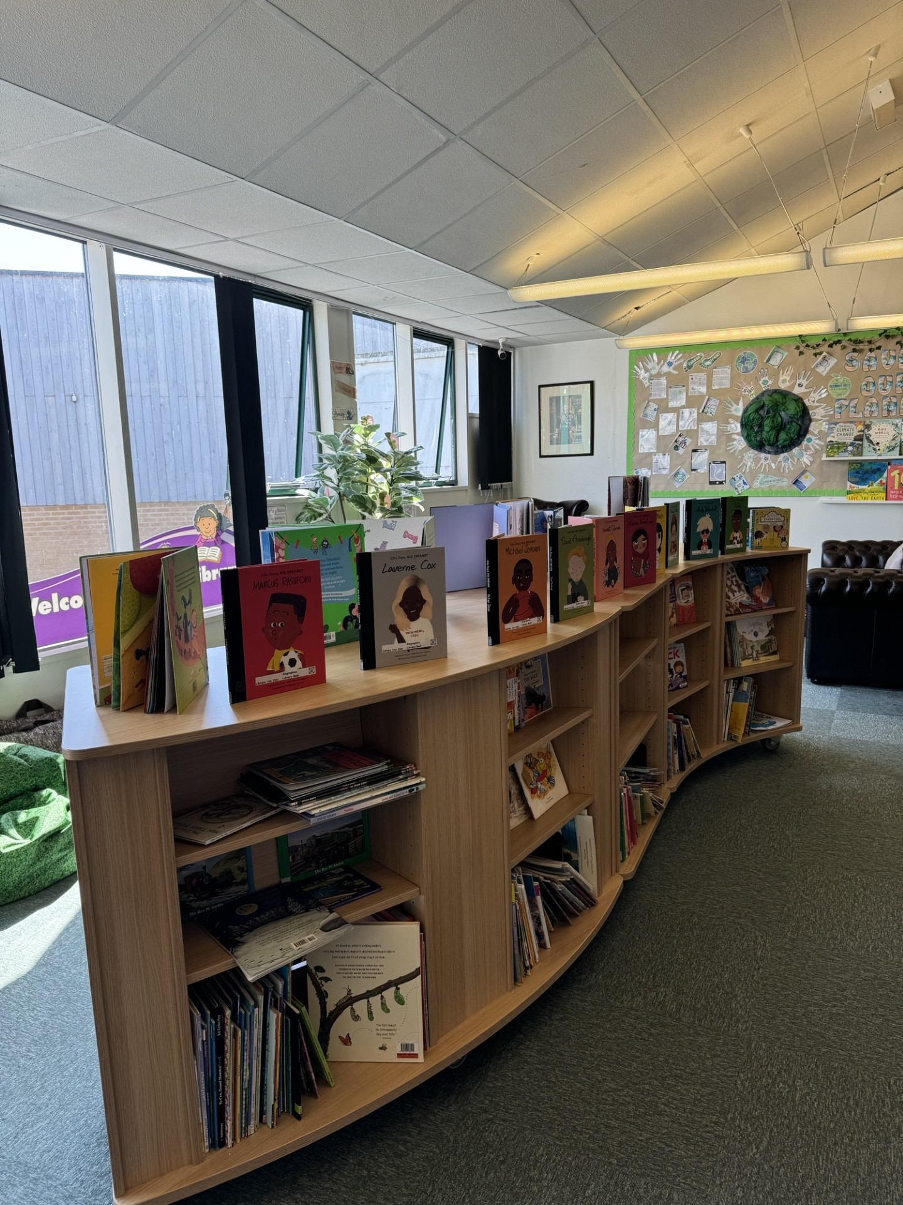
Cedars School Library
Librray Monitors
Lunch Time Reading Buddies
Reading Anbvassadors

Slide 3
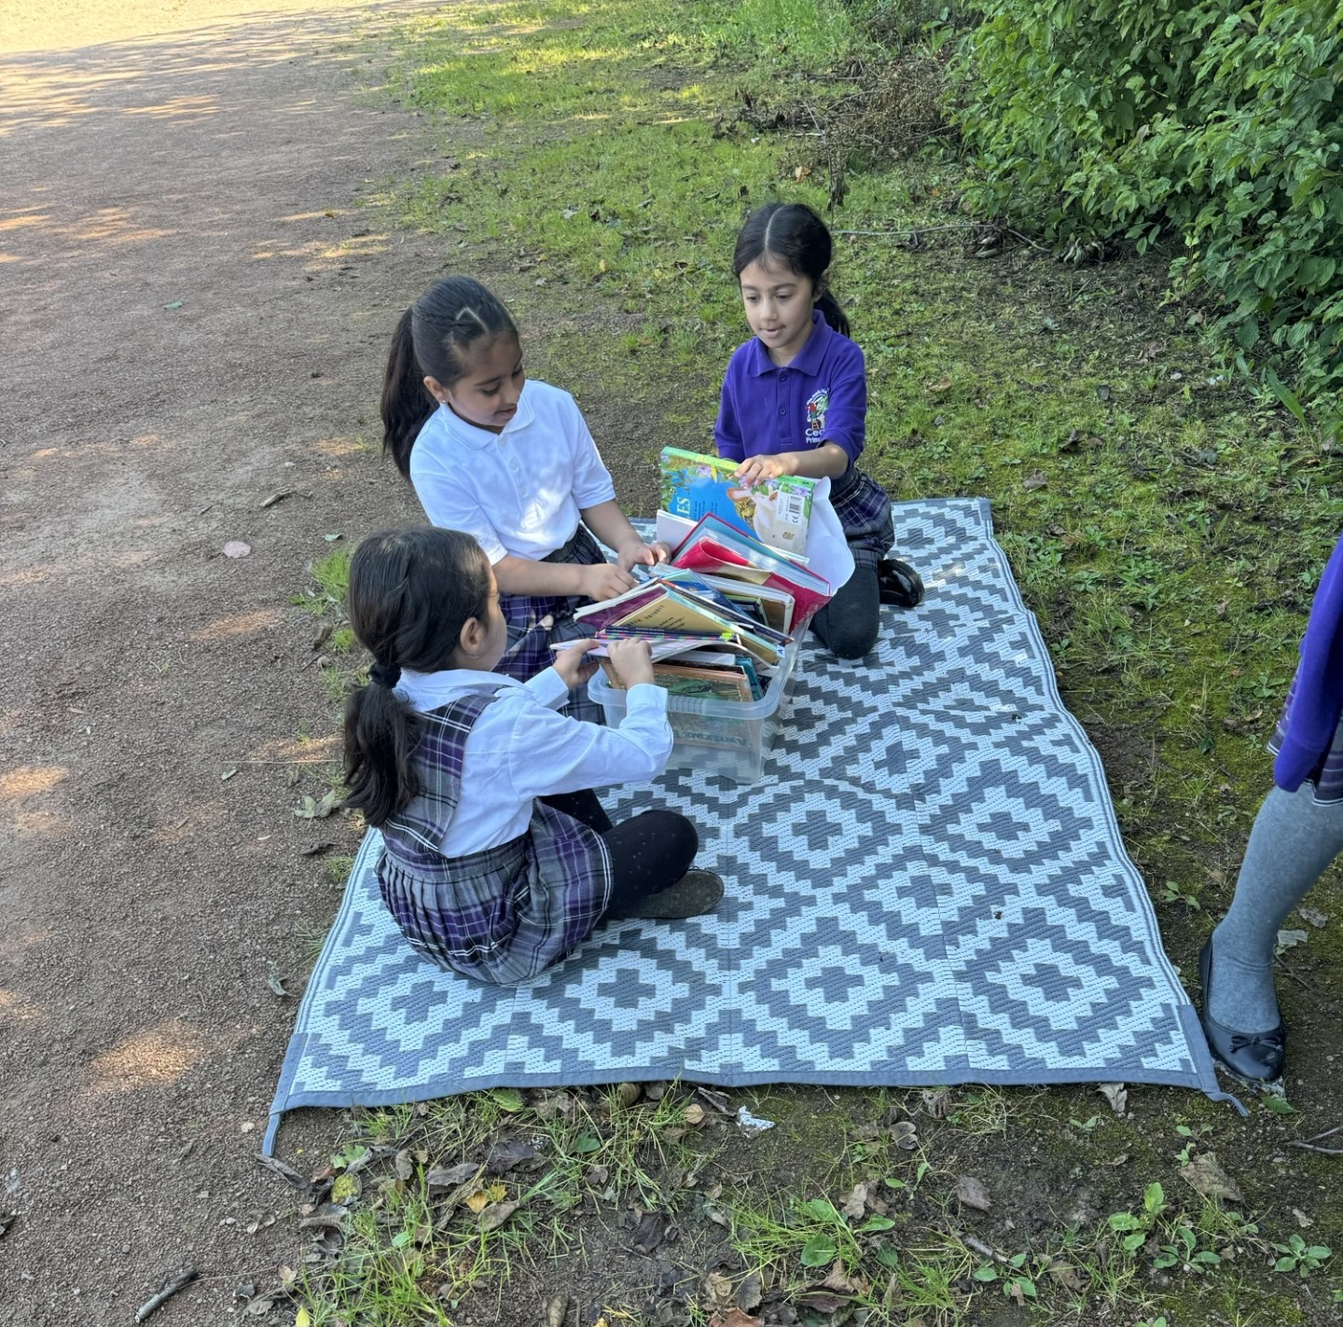
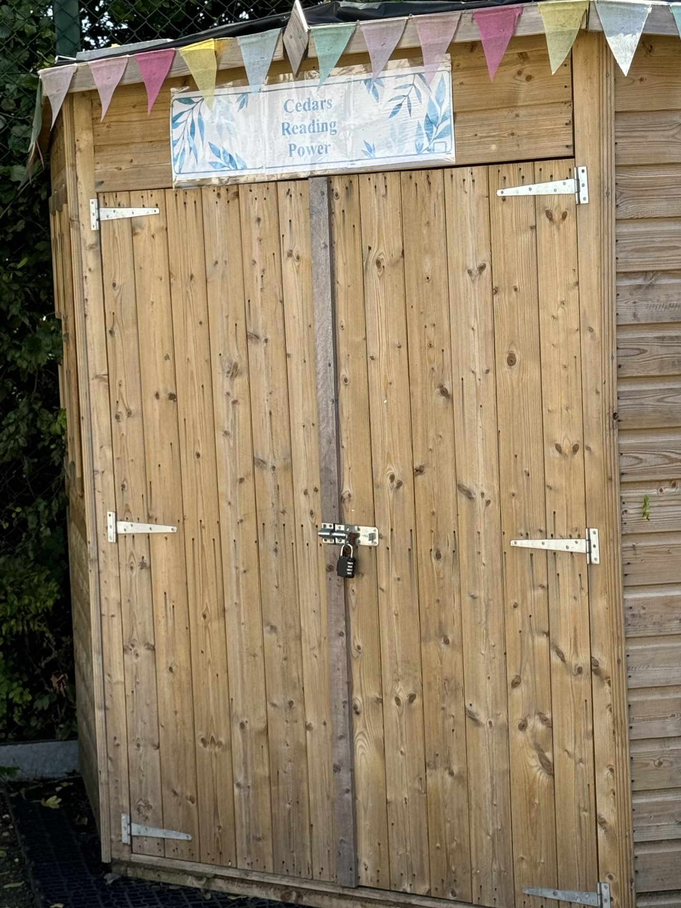
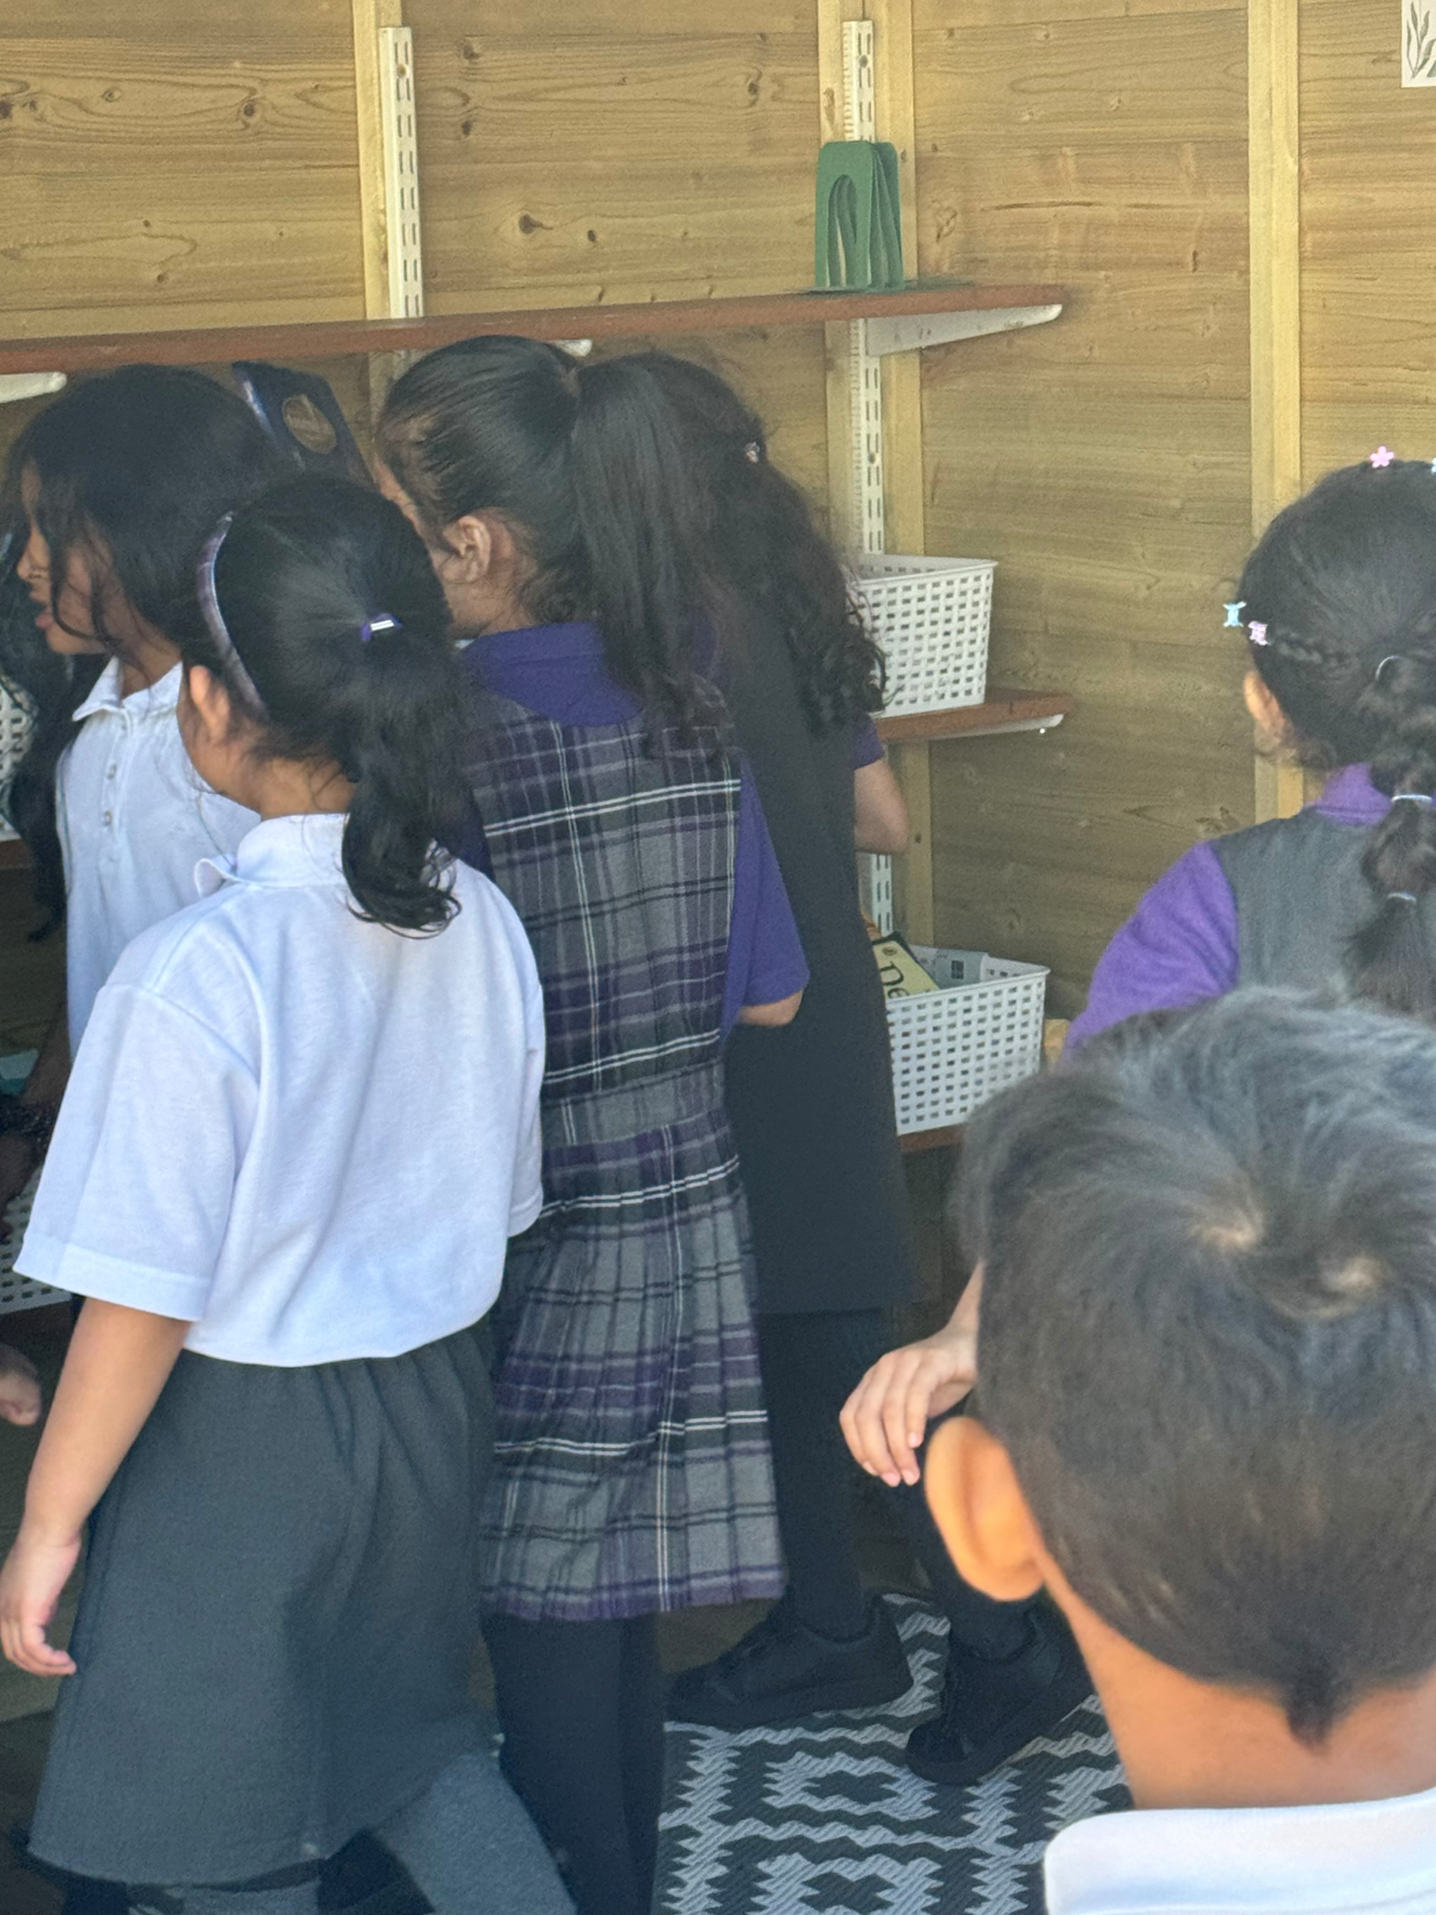
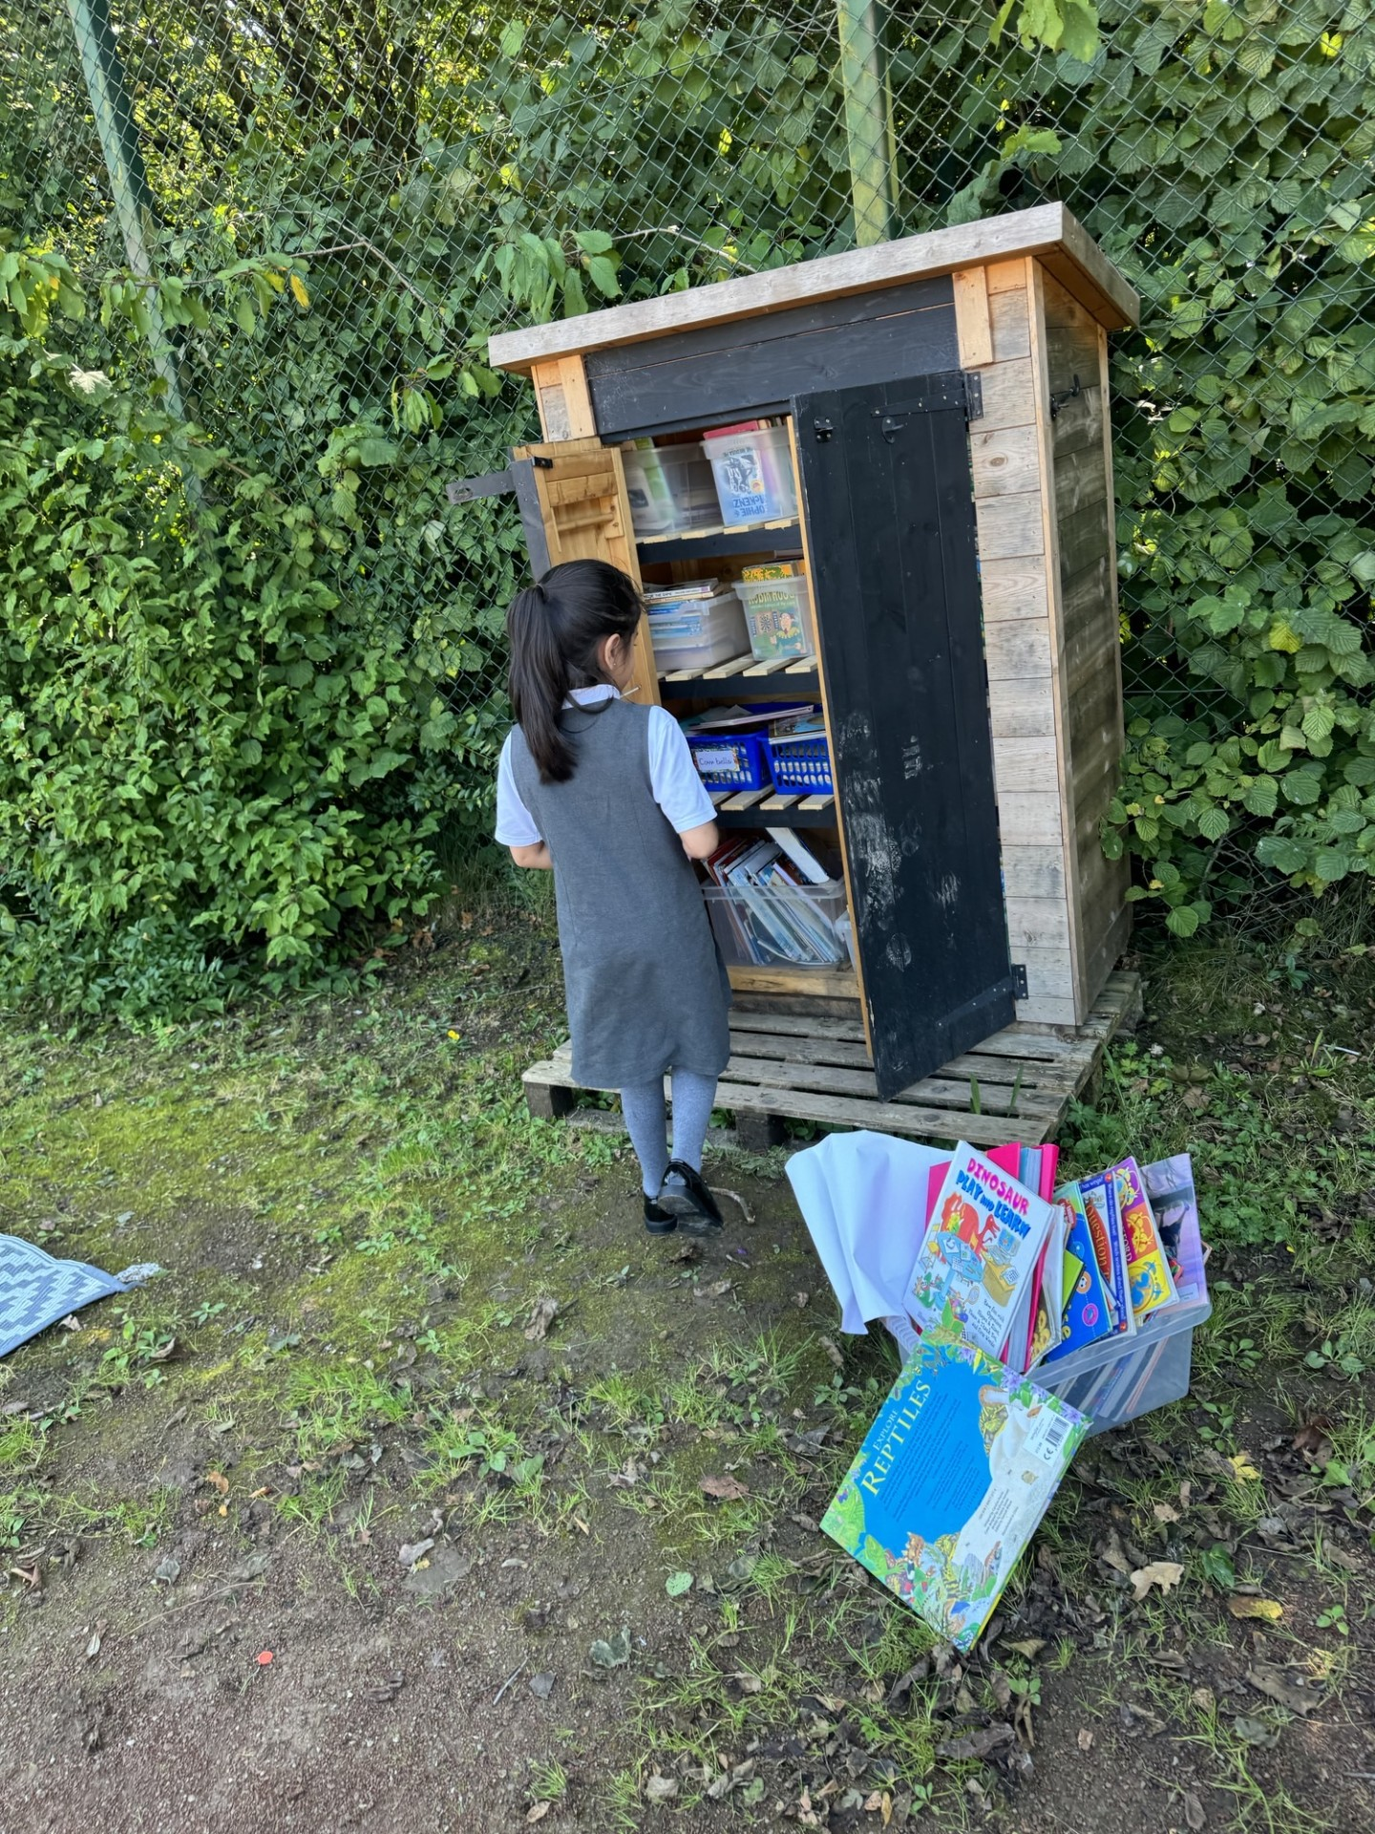
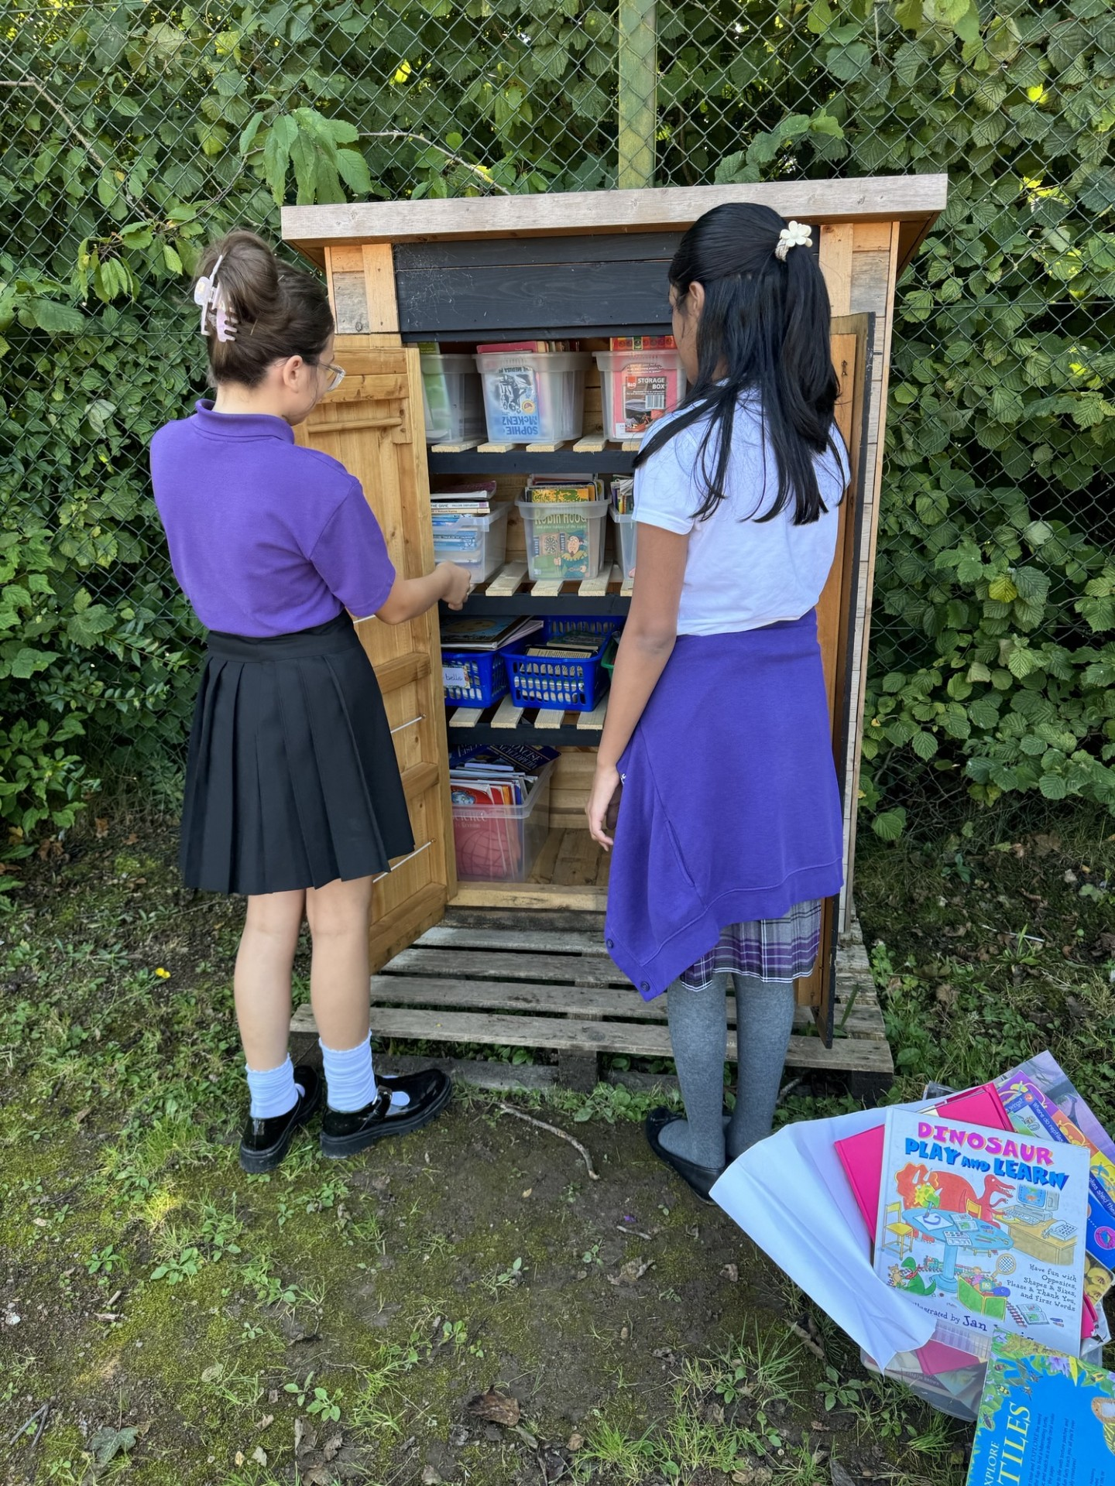
Reading Sheds
How will we look after them?
Do we have monitors for the Reading Sheds?
Leave the Reading shed tidy

Slide 4
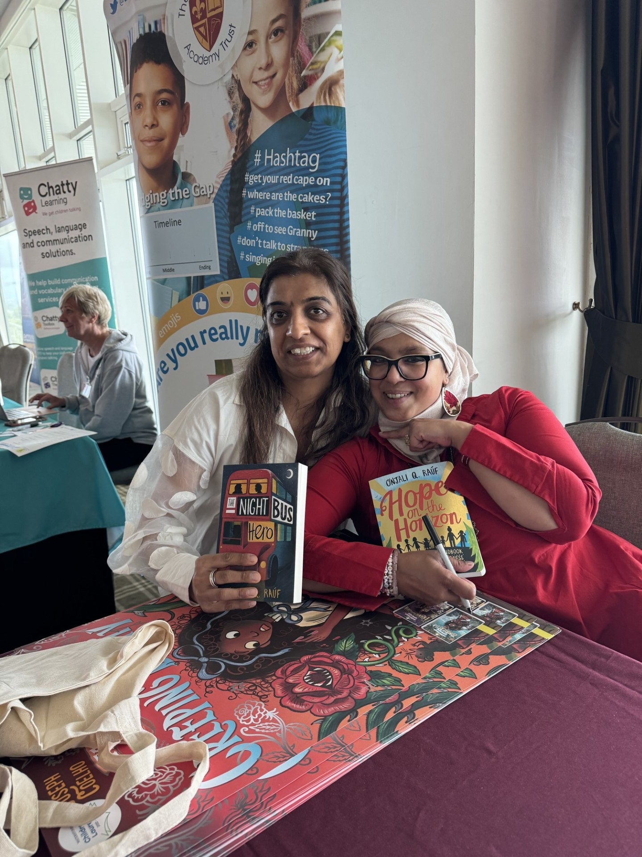
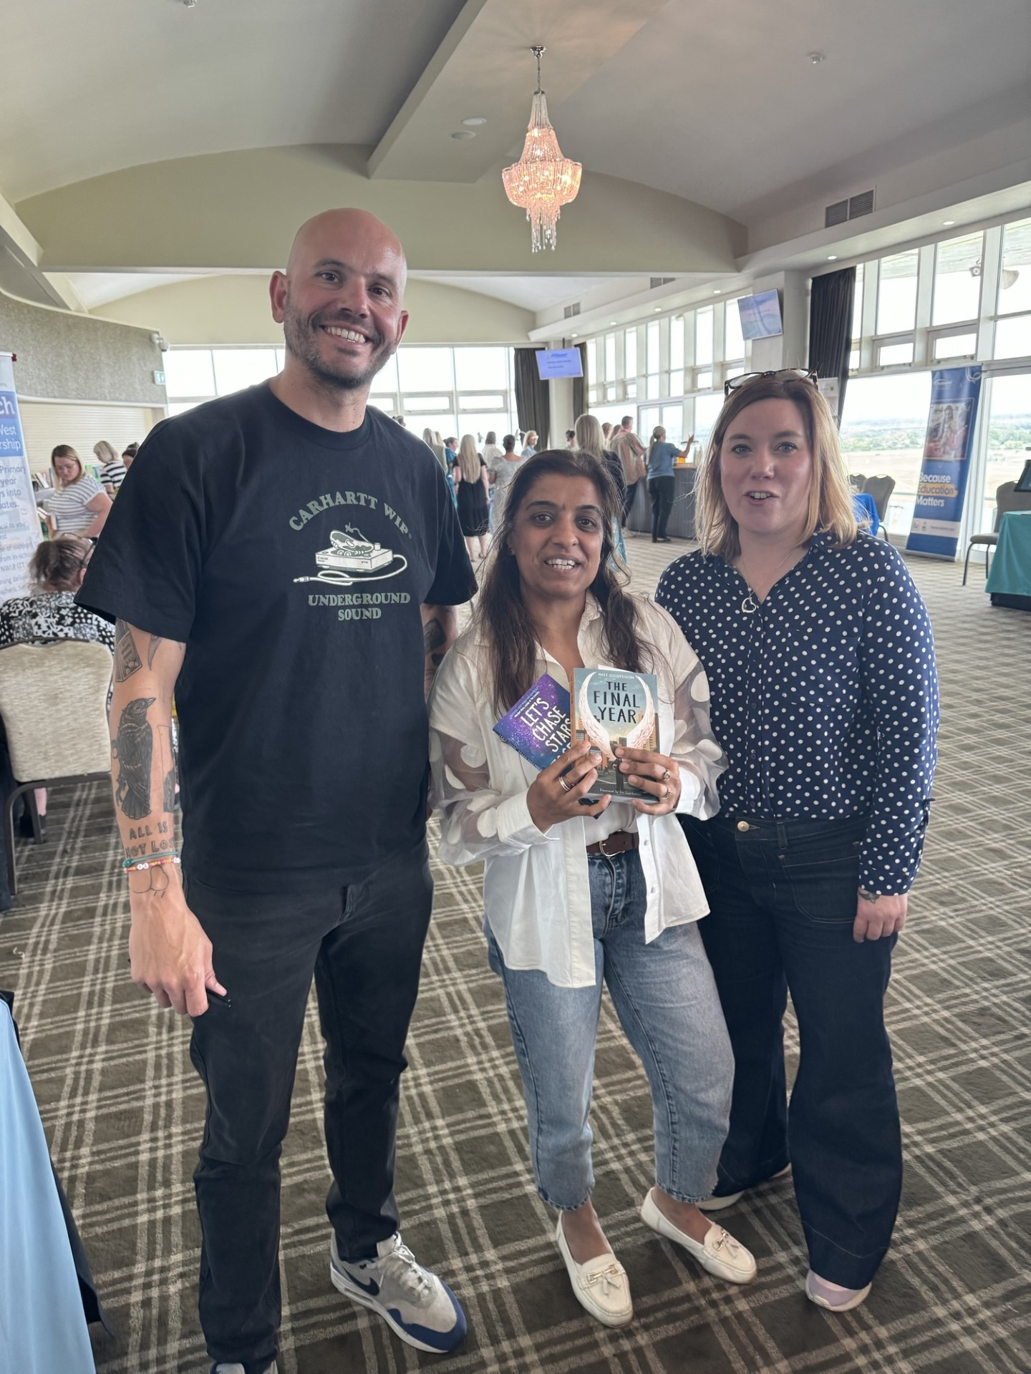


Meet the Authors
UK Children's Laureate:
The job of the Children's Laureate is to get children excited about books, reading and writing!
British children's author Frank Cottrell-Boyce has been named the Children's Laureate for 2024-2026. The special role is awarded every two years to a well-known writer or illustrator in recognition of their talent.

Slide 5
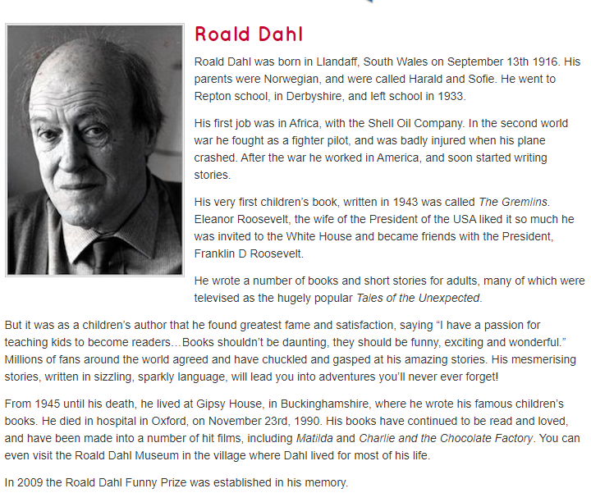
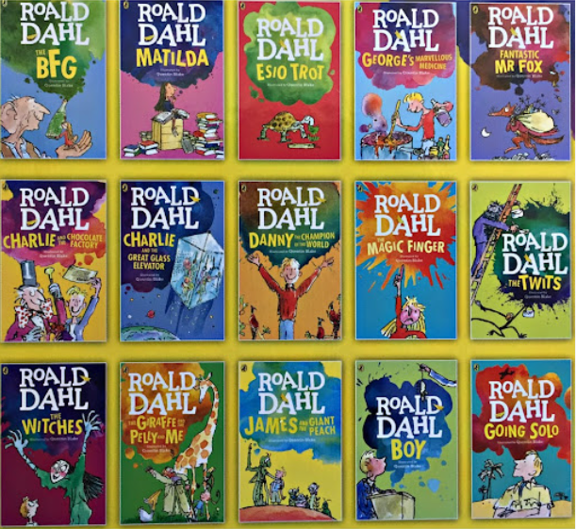
Guess the Author

Slide 6
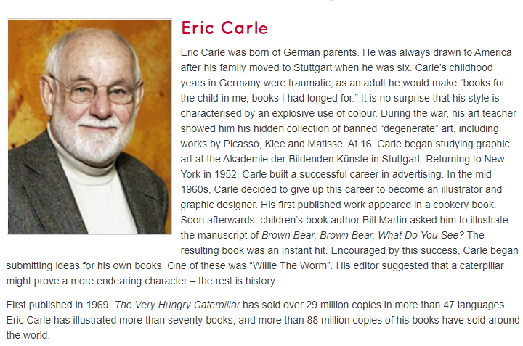
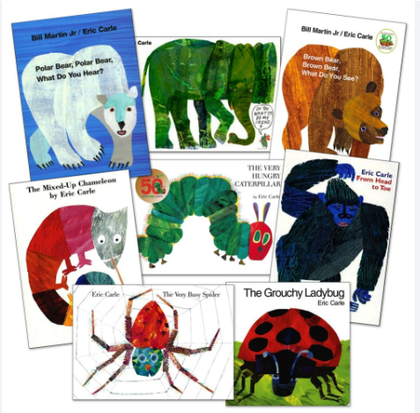
Guess the Author

Slide 7
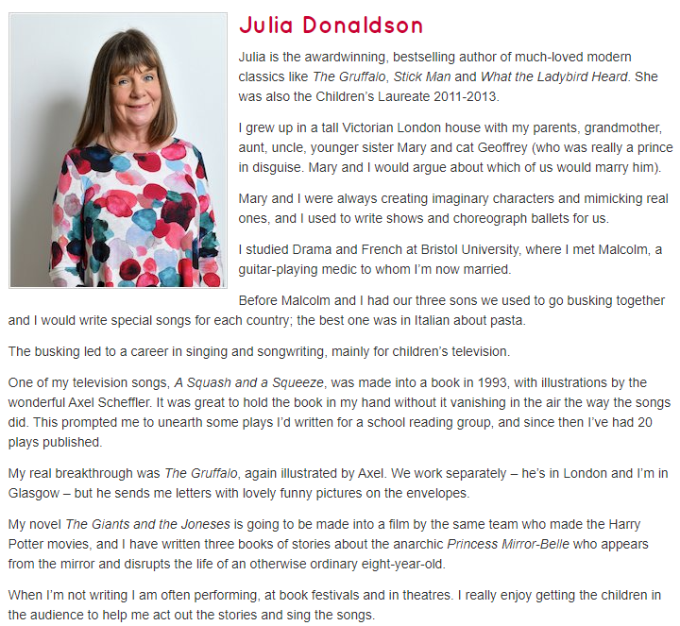
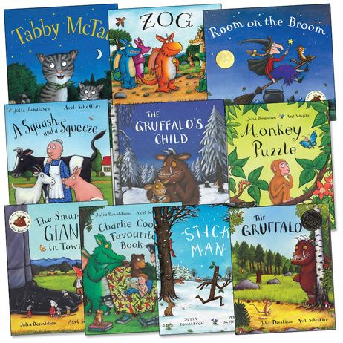
Guess the Author

Slide 8
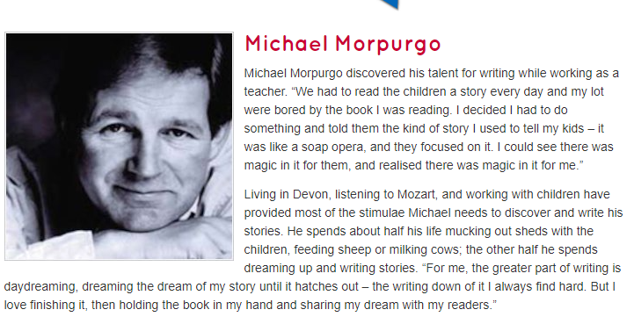

Guess the Author

Slide 9
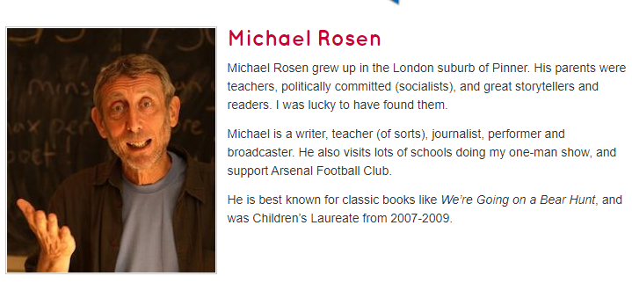

Guess the Author

Slide 10
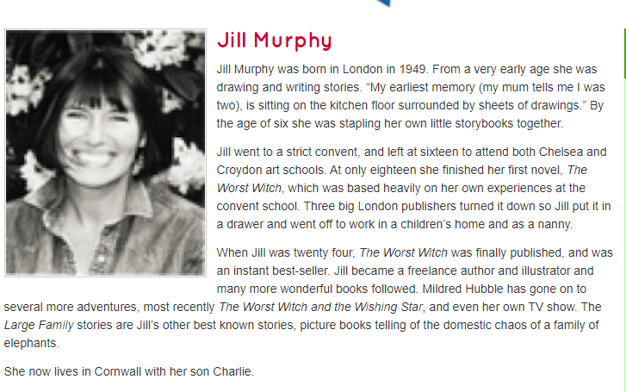

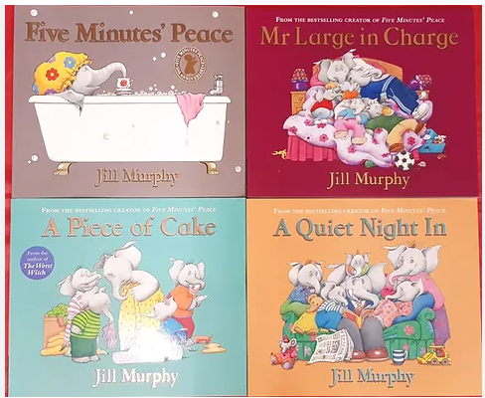
Guess the Author

